Slide 1
Overview of the CELG’s
Manuscript on Strategies and Actions for Strengthening Last Mile Population
Engagement in Health and Pandemic Governance
Jeremiah Carlo V. Alejo, MD

Slide 2
CELG Target Last Mile Populations
Country | Partner Organization | Last Mile Population
Philippines | Action for Health Initiatives | Tricycle (tuktuk) drivers
Indonesia | Jaringan Indonesia Positif | Current and former prisoners
Cambodia | KHANA | Internal migrant workers, construction and garment workers
Sierra Leone | CISMAT-SL | Persons living with disability
Nigeria | Janna Health Foundation | Internally displaced persons and nomads
Mozambique | ADPP | Miners and ex-miners, internally displaced peoples, nomads
Cameroon | For Impacts in Social Health | Internally displaced persons
Kenya | Stop TB Kenya | Persons Living with Disability

Slide 3
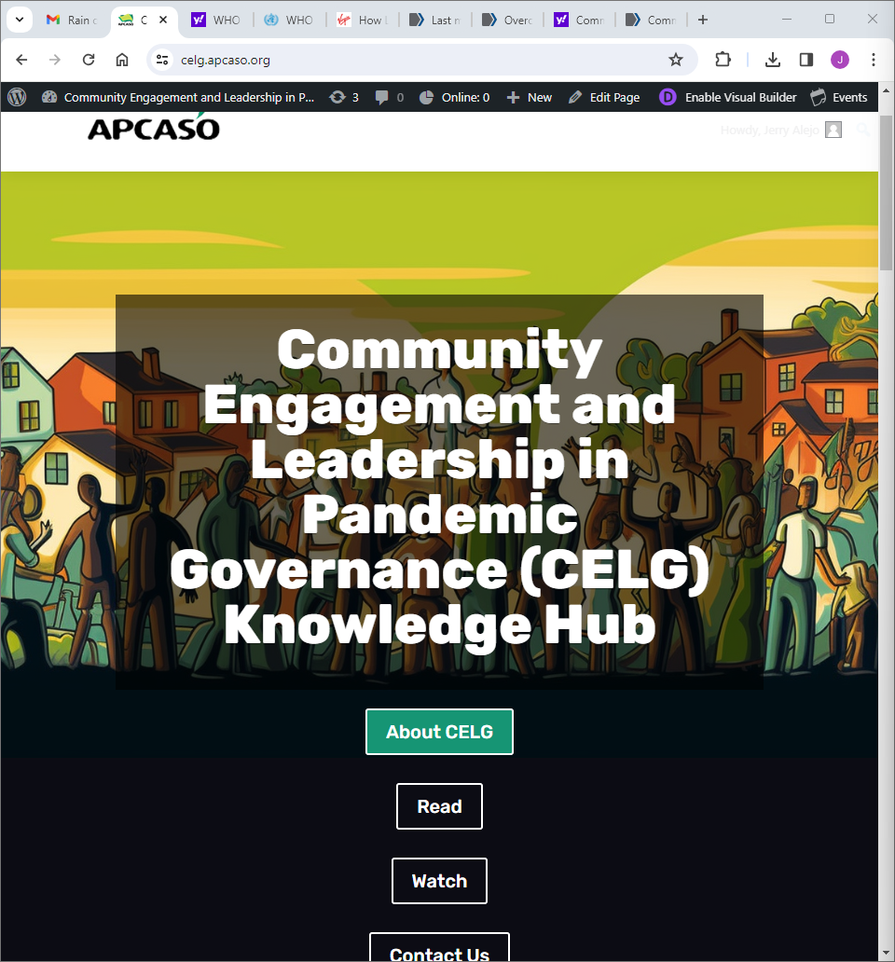
Community Engagement in Leadership in Pandemic Governance Knowledge Hub
Webinar series focused on strengthening LMP capacities to engage in health and pandemic governance
Website to serve as an extension venue for discussion and repository of resources related to the objectives

Slide 4
Purpose of the Manuscript: Sharing Lessons
Document the assumptions and rationale behind the project
Describe identified expected outcomes related to LMP engagement in health and pandemic governance
Discuss strategies/action areas in strengthening the capacities for LMPs to engage in health and pandemic governance

Slide 5
Outline of the Proposed Manuscript
Introduction and Background
CELG Participants’ Expected Outcomes in Strengthening Capacities for LMPs to Engage in Health and Pandemic Governance
CELG Areas of Action for Building the Capacities of LMPs to Engage in Platforms for Health and Pandemic Governance
Initial Results of CELG Engagement Plan Implementation

Slide 6
Outline of the Proposed Manuscript
Background
  Last Mile Populations as defined in the context of Health
  Brief Overview of CELG
  The Effects of the COVID-19 Pandemic on TB Last Mile Population
  Community Engagement in Health and Pandemic Governance as Platform for Last Mile Population Capacity-Building
  Purpose of the Manuscript

Slide 7
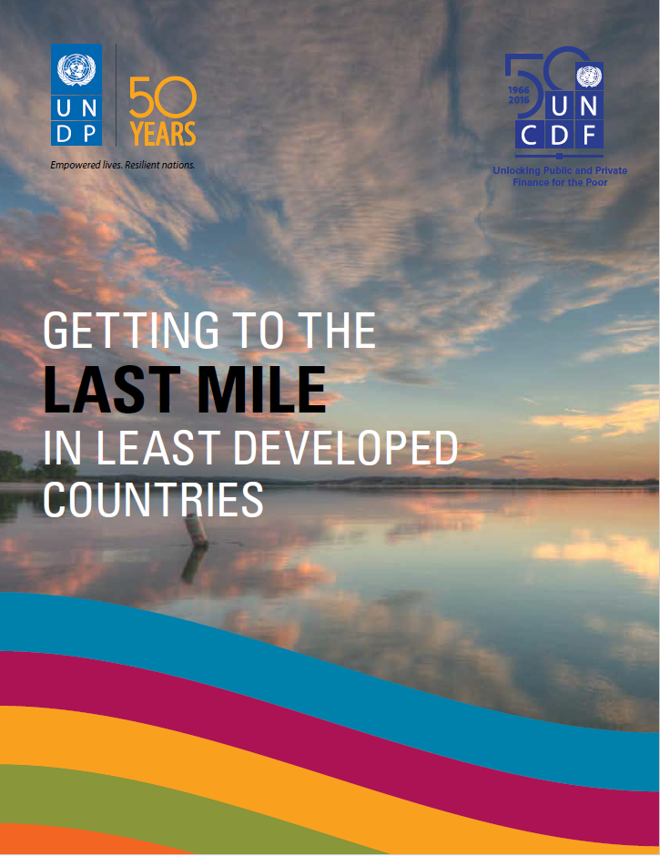
“By the last mile, we are referring not only to the poorest of the poor, but also to the people, places and small enterprise levels that are under-served and excluded , where development needs are greatest, and where resources are most scarce…millions of people are not benefiting from the fruits of development, especially the poorest and those disadvantaged because of their sex, age, disability, ethnicity, or geographic location.”
-UNDP

Slide 8
Common Vulnerabilities among TB LMP
increased exposure to infectious diseases
lack of access to health services, including health information, due to poor resources
limited representation in health governance decision-making
Specific vulnerabilities: occupational exposure, stigma and societal distrust, physical inaccessibility, communication barriers, financial inaccessibility

Slide 9
Effects of the COVID-19 Pandemic on TB and Support Services
Disruptions in the delivery of services and administration of programs
  due to travel restrictions
  Interrupted supply chains
Avoiding consultation due to fear of implications of being identified as a COVID-19 suspect
Poor utilization of preventive services due to misconceptions about diseases and health products

Slide 10
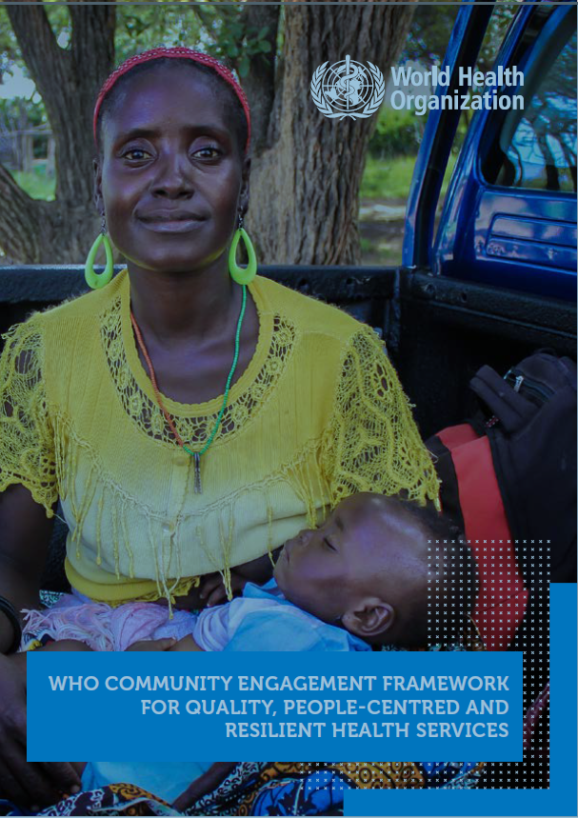
A chain is only as strong as its weakest link.
“Improving the quality of health care and services and being responsive to the needs and preferences of local communities cannot be done without the individuals and teams responsible for designing, managing and delivering health care talking and interacting with each other, as well as engaging with service users and other stakeholders about how best to do this.”
- World Health Organization

Slide 11
Outline of the Proposed Manuscript
II. CELG Participants’ Expected Outcomes in Strengthening Capacities for LMPs to Engage in Health and Pandemic Governance
Goal: Last mile populations as active participants in health and pandemic-related policy-making, and service program design and delivery

Slide 12
Outline of the Proposed Manuscript
II. CELG Participants’ Expected Outcomes in Strengthening Capacities for LMPs to Engage in Health and Pandemic Governance
Objectives:
Develop organizational and leadership capacities among LMPs to engage in health and governance
Create and strengthen health and pandemic governance-related platforms for community participation, particularly last mile populations

Slide 13
Outline of the Proposed Manuscript
III. CELG Areas of Action for Building the Capacities of LMPs to Engage in Platforms for Health and Pandemic Governance
  Identifying and Assessing the Needs, Capacities, and Resources of LMPs
  LMP Organizing and Capacity-Building Activities
  Establishing and Strengthening Platforms for LMP Engagement in Health and Pandemic Governance
  Addressing specific vulnerabilities
  CSO capacity-building for strengthening LMP engagement

Slide 14
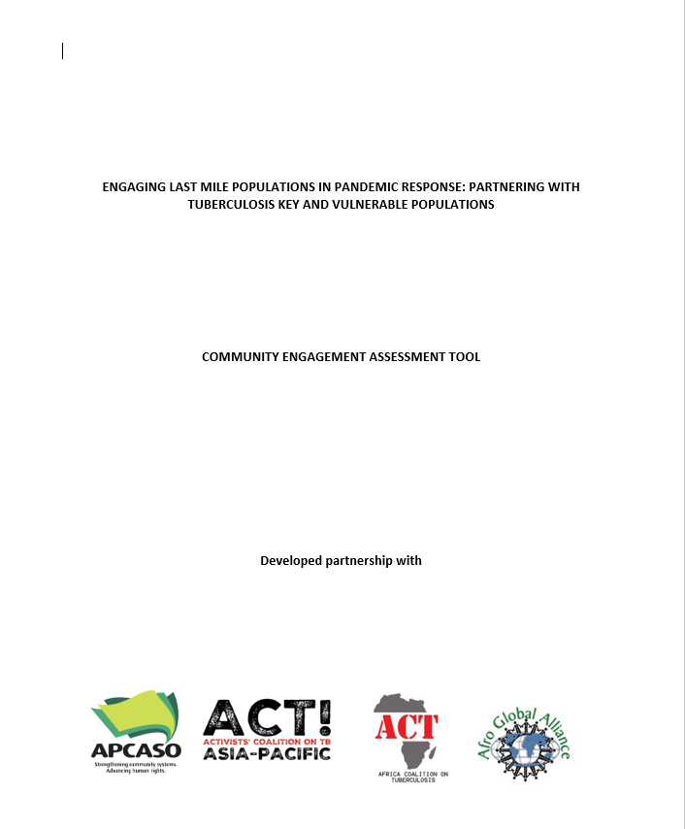
Outline of the Proposed Manuscript
III. CELG Areas of Action for Building the Capacities of LMPs to Engage in Platforms for Health and Pandemic Governance
  Identifying and Assessing the Needs, Capacities, and Resources of LMPs
    ACT Africa and ACT Asia-Pacific Community Engagement Assessment Tool

Slide 15
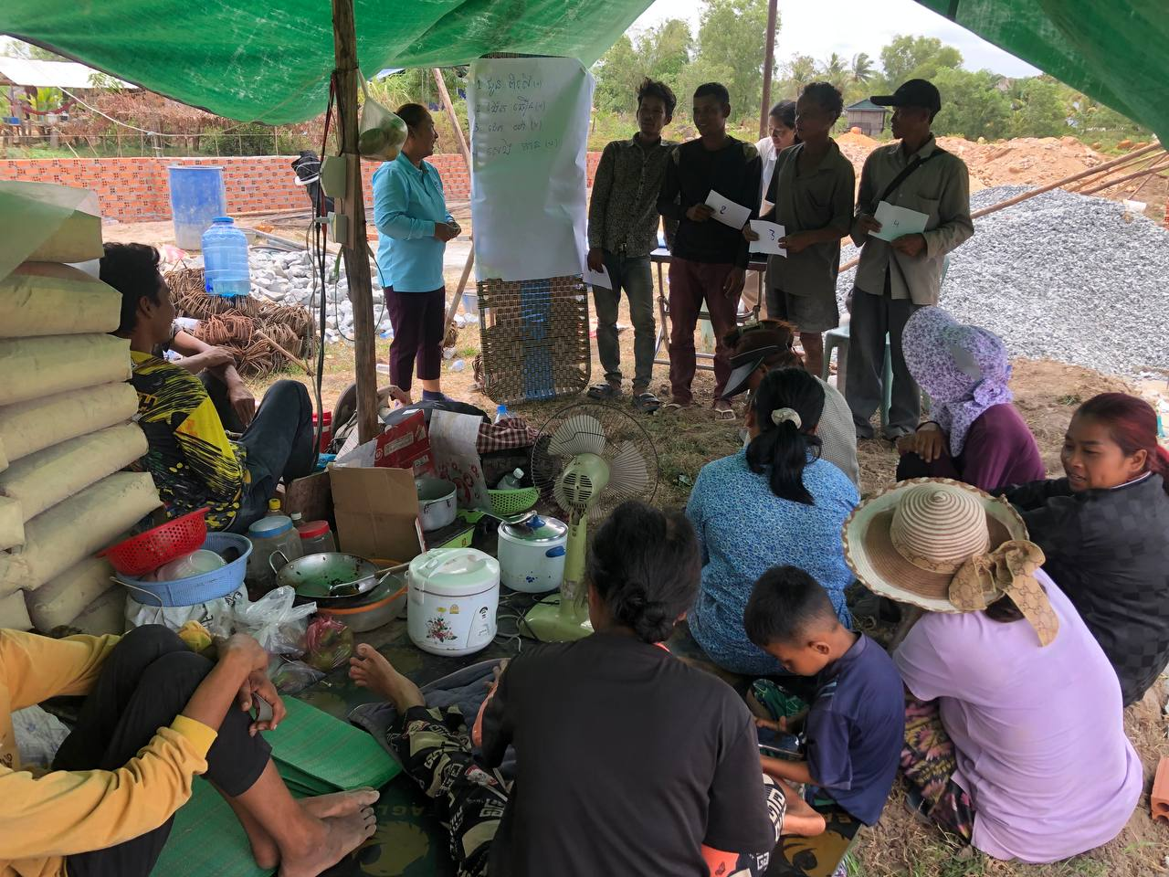
Outline of the Proposed Manuscript
III. CELG Areas of Action for Building the Capacities of LMPs to Engage in Platforms for Health and Pandemic Governance
  LMP Organizing and Capacity-Building Activities
    Information, Education and Campaigns on Key Health Topics: TB, COVID-19 PPPR

Slide 16
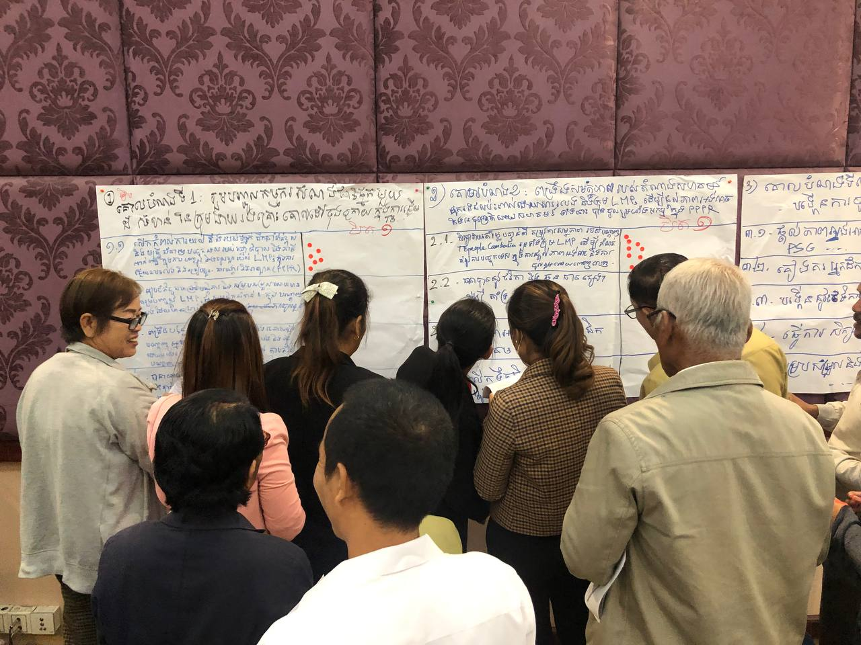
Outline of the Proposed Manuscript
III. CELG Areas of Action for Building the Capacities of LMPs to Engage in Platforms for Health and Pandemic Governance
  LMP Organizing and Capacity-Building Activities
    Community/Group Organizing and Leadership Development
      Key Organizational Capacity Development Areas: Advocacy and Representation, Communication Models and Channels, Linkaging and Collaboration, Funding and Sustainability, Action and M&E Planning

Slide 17
Outline of the Proposed Manuscript
III. CELG Areas of Action for Building the Capacities of LMPs to Engage in Platforms for Health and Pandemic Governance
  LMP Organizing and Capacity-Building Activities
    Providing incentives and support for participation and representation
    Facilitating network-building and linkaging

Slide 18
Outline of the Proposed Manuscript
III. CELG Areas of Action for Building the Capacities of LMPs to Engage in Platforms for Health and Pandemic Governance
  Establishing and Strengthening Platforms for LMP Engagement in Health and Pandemic Governance
    Stakeholder Mapping
      Purpose
      Identified significant stakeholders and why
    Advocating for LMP Engagement
      Purposes and methods

Slide 19
Outline of the Proposed Manuscript
III. CELG Areas of Action for Building the Capacities of LMPs to Engage in Platforms for Health and Pandemic Governance
  Establishing and Strengthening Platforms for LMP Engagement in Health and Pandemic Governance
    Coordinating for LMP engagement planning in health and pandemic governance and service delivery,
      including facilitating communication among stakeholders, particularly LMPs with language/communication barriers
    Developing monitoring mechanisms for LMP engagement and representation

Slide 20
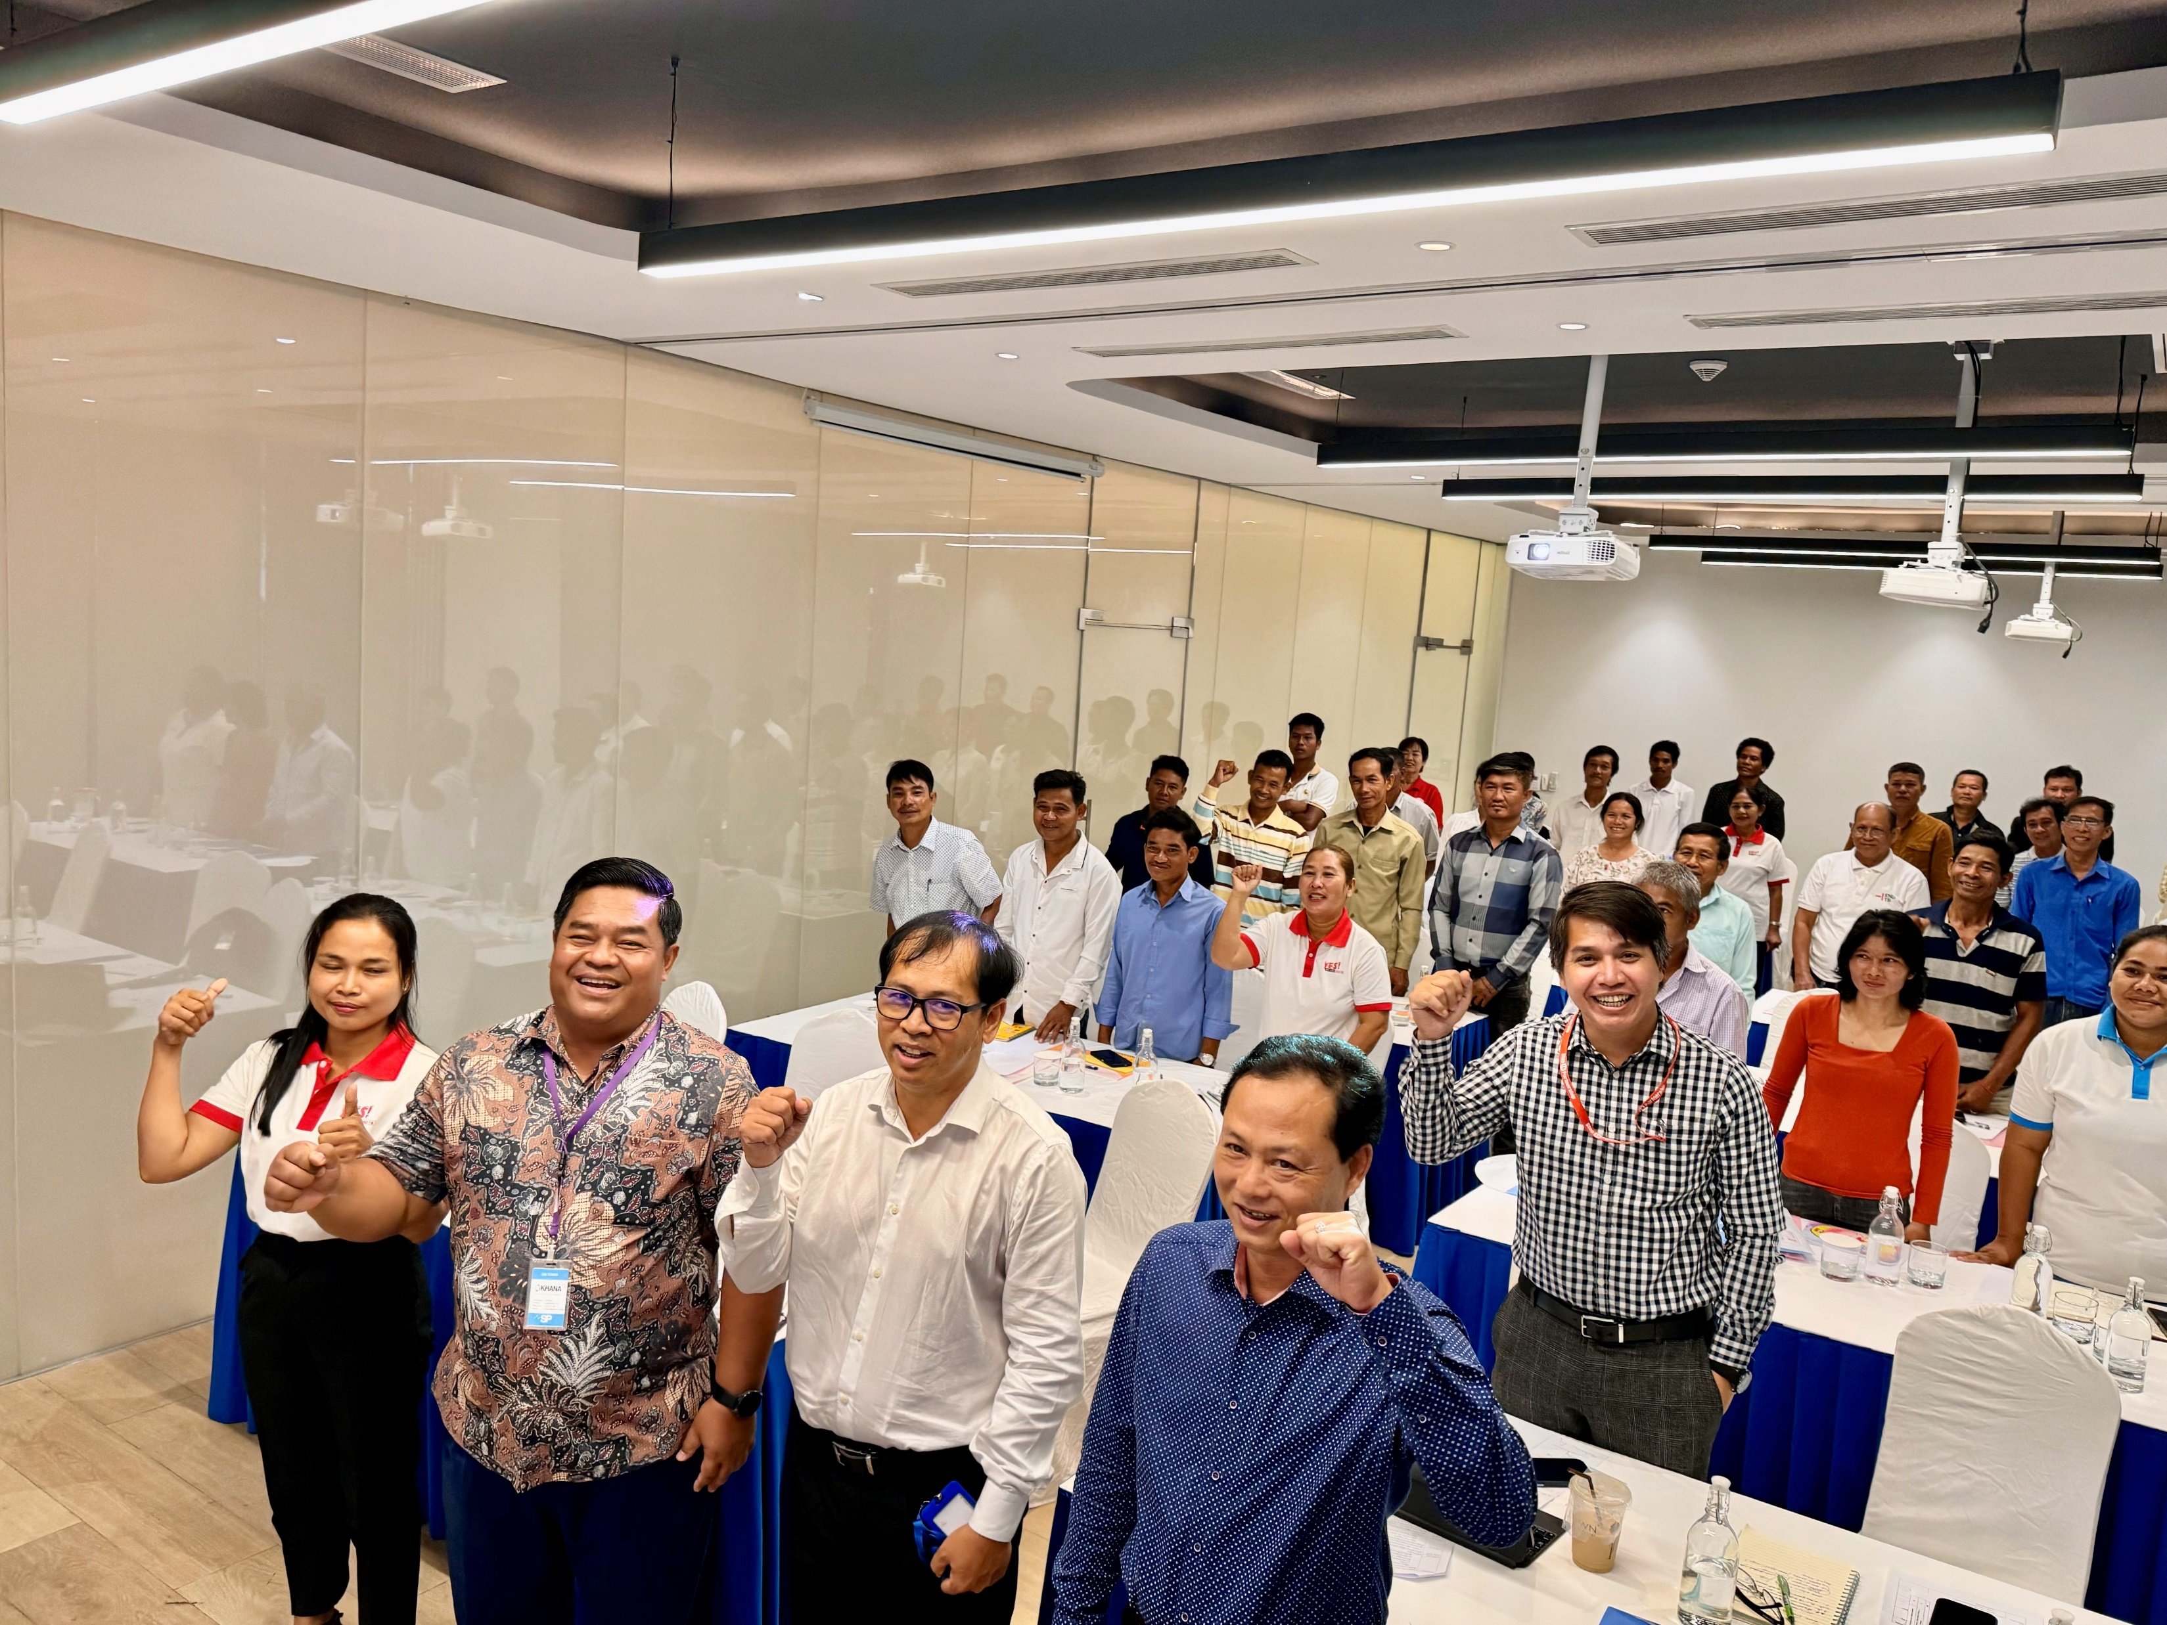
Outline of the Proposed Manuscript
III. CELG Areas of Action for Building the Capacities of LMPs to Engage in Platforms for Health and Pandemic Governance
  CSO capacity-building for strengthening LMP engagement
    Recommended CSO capacities to facilitate LMP engagement strengthening
  Addressing specific vulnerabilities
    Improving health service delivery: accessibility
    Addressing cultural barriers and stigma
    Providing social safety nets

Slide 21
Outline of the Proposed Manuscript
Initial Results of CELG Engagement Plan Implementation
  CSOs: Development of scalable community engagement models; development of training designs for LMPs
  LMPs: formation of committees, identified leaders and champions, inclusions in networks, registration of organized groups, development of action plans for engagement
  Institutions: creation of communication channels, inclusion in decision- making process for policies and program development

