Slide 1
Lessons in Capacity Building and Engaging the Tricycle Operators and Drivers' Association (TODA) as a
Last Mile Population (LMP) Philippines

Slide 2
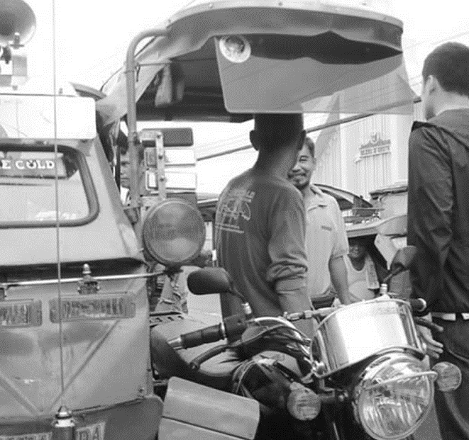
Background of the LMP
ACHIEVE identified the Tricycle Owners and Drivers Association (TODA) as the focus of TB key and vulnerable population for this project.
The project recognized their important role during the pandemic, as well as their vulnerabilities and risks related to TB and other health conditions, including emerging health emergencies. The lack of awareness of TB among TODA members indicates that this particular group of urban dwellers remained unreached.
They are often exposed to risky work environments, including first and secondhand cigarette smoke, as well as other forms of air pollution, poor nutrition, challenging weather conditions, and crowded areas. Despite these exposures, their health-seeking behaviors are poor.

Slide 3
Background of the LMP
Surveys and FGDs among TODA community revealed a significant lack of awareness regarding institutions, structures, and mechanisms related to TB, but is not true with COVID-19.
Community engagement on both TB and COVID-19 was reported to be poor across various aspects such as information, consultation, collaboration, empowerment, and participation. The TODA community is not accustomed to participating in health-related projects.
The TODA community expressed the need for TB-COVID-19 awareness during the costed community engagement planning workshop. They are facing a conflict because as daily wage earners, they find it difficult to take time off from work as tricycle drivers to participate in community or health-related activities.
Notes:
To strengthen and support the identified LMP (TODA), CELG Philippines has partnered with the City Health Department of Quezon City, Tricycle Regulation Division, Quezon City TODA Federation, Culion Foundation, Inc., Innovations for Community Health, Inc. (ICH), FHI 360, and Breathe Free PH and TB Health Education and Livelihood Support (TB HEALS) Community, Inc. The last two are community-based organizations working on TB elimination and are members of the Philippine Alliance to Stop TB (PASTB), a network of CSOs/CBOs, NGOs, and stakeholders working on TB.
The partnership established with the above-mentioned organizations has increased the likelihood of engagement of the group in Pandemic Preparedness and Response (PPR). Their participation in the activities has boosted the morale of the TODA participants, as evidenced by the increased number of TODA community members participating in activities for CELG – from surveys, FGDs, Pre-validation, and planning workshops to the TODA Peer Educators’ Training of Trainers.

Slide 4
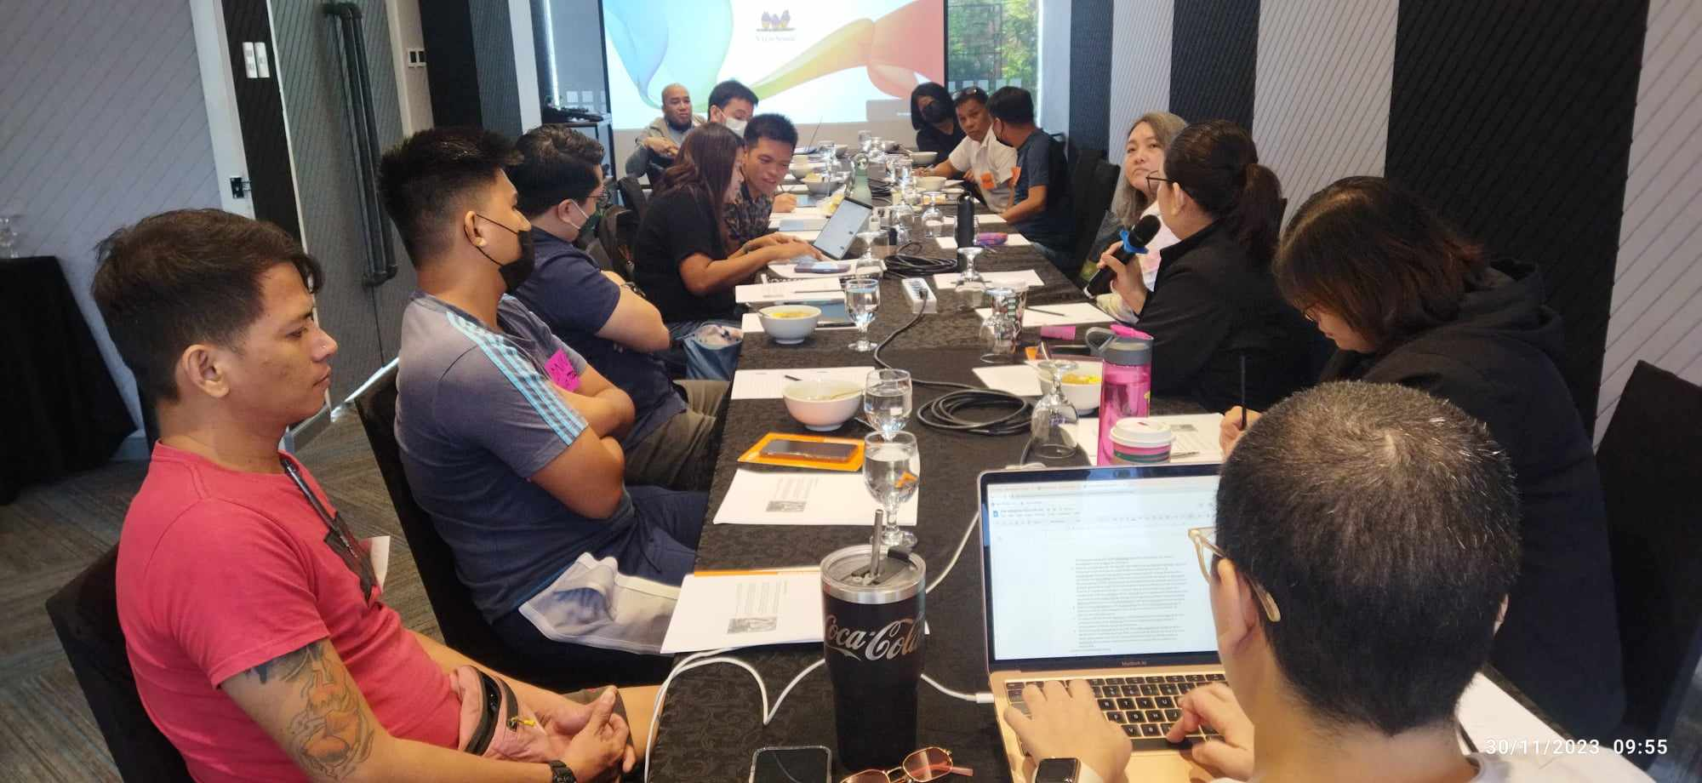
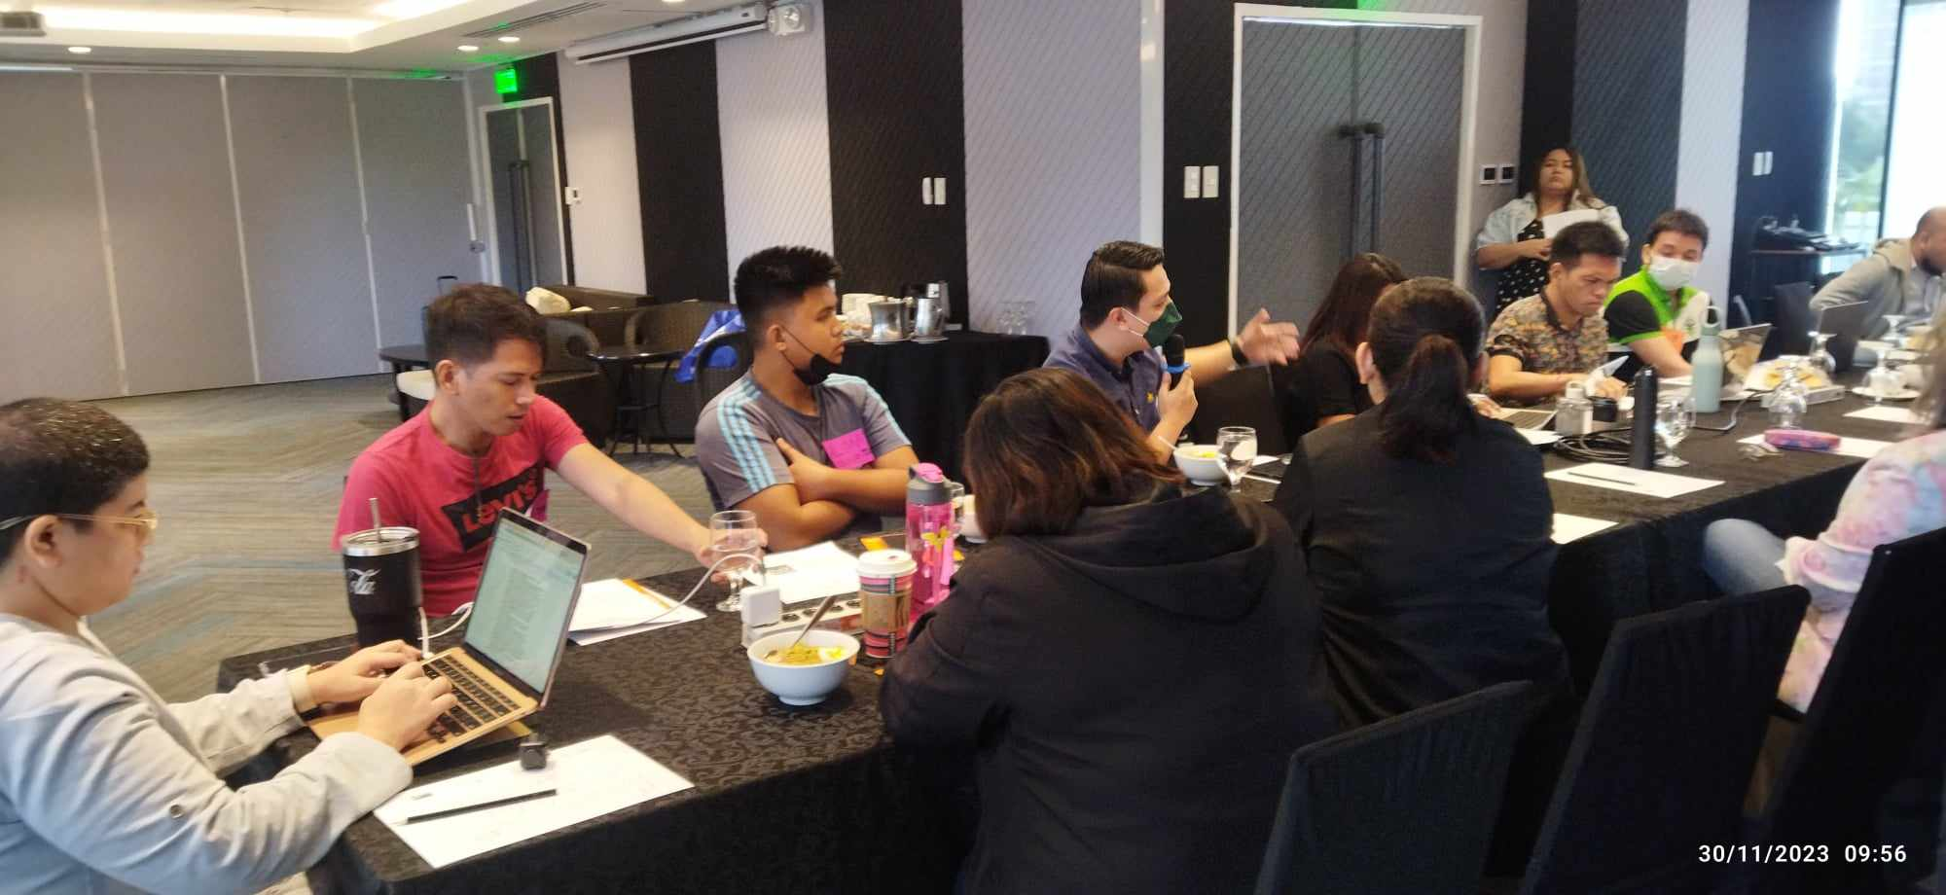
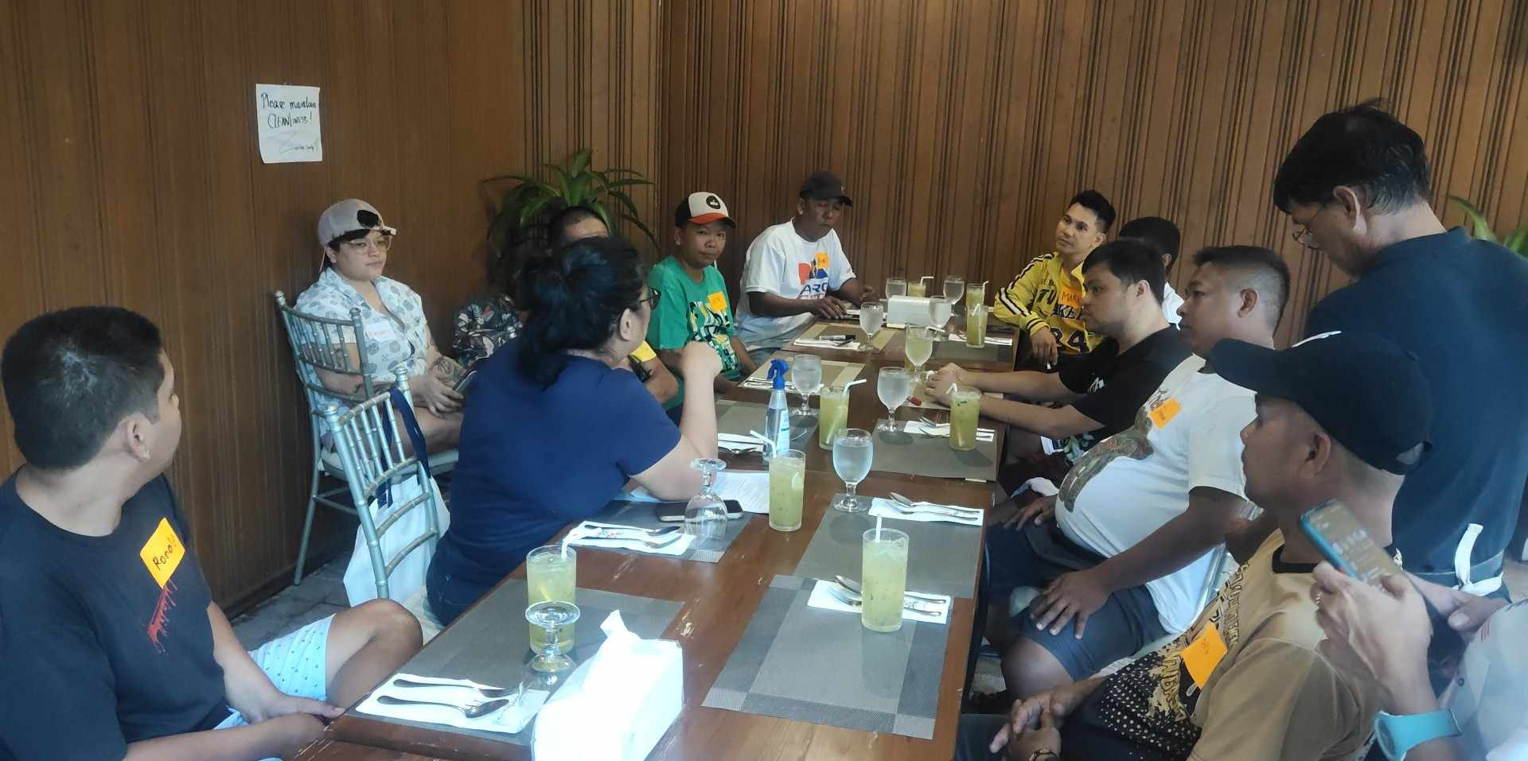
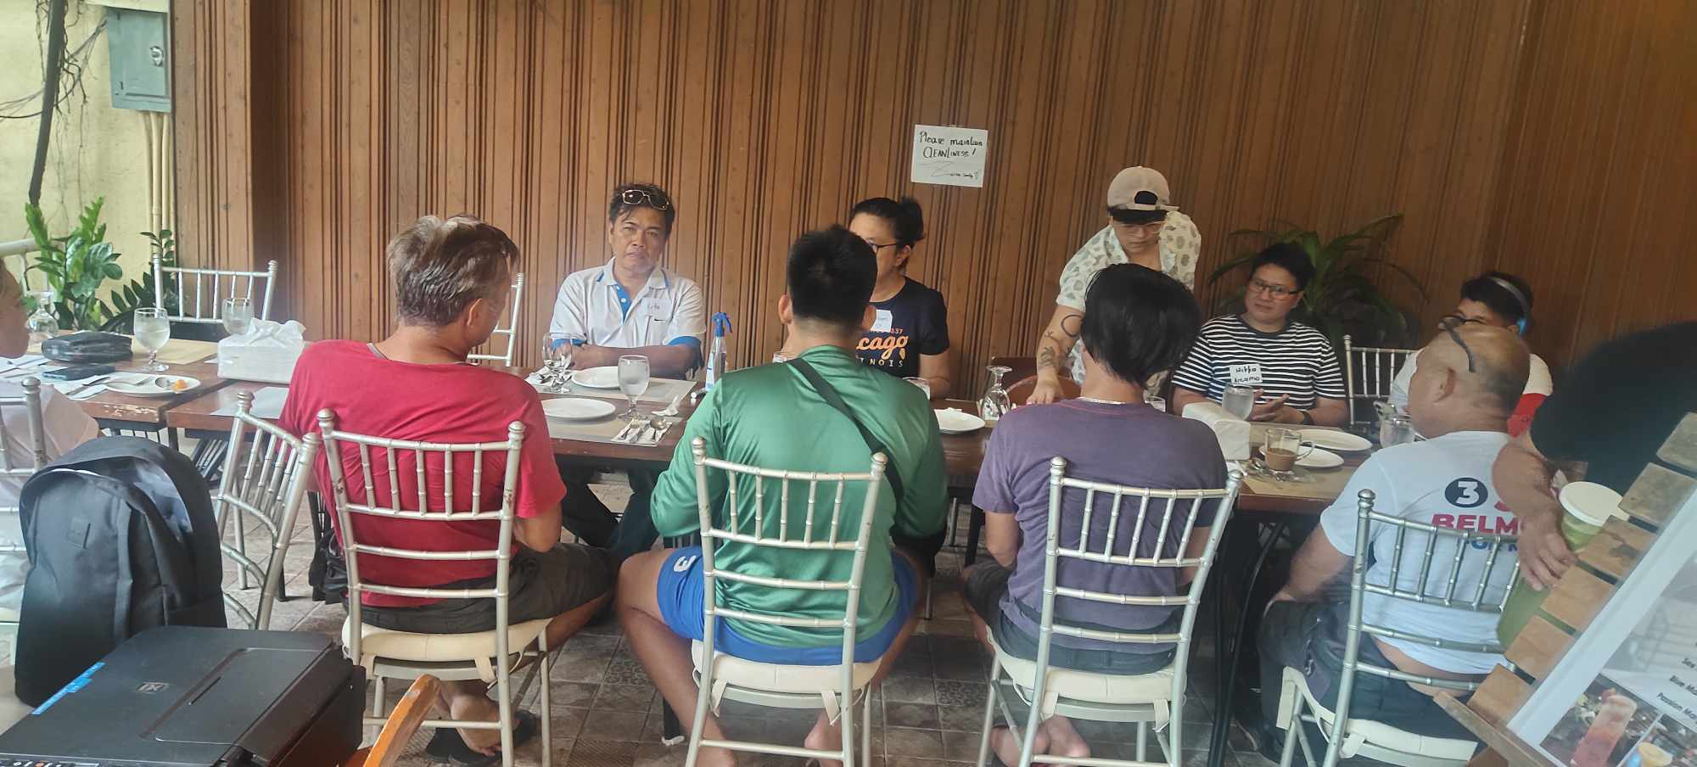
Community Engagement Plan and Interventions
Notes:
18 TODA members from 9 TODA groups participated in the Focus Group Discussion (FGD) held on October 14, 2023.
Only two members of the TODA showed up for the Pre-validation FGD, even though they were invited to participate.

Slide 5
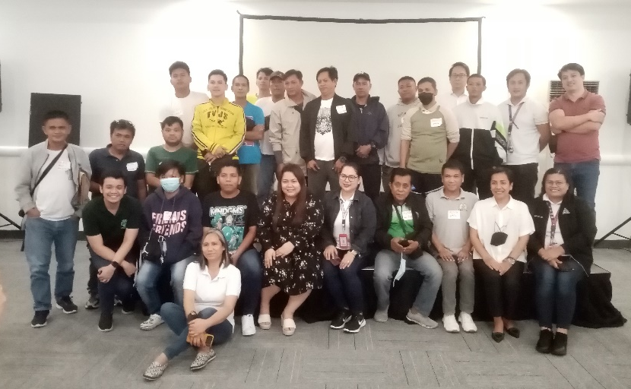
Costed Community Engagement Planning Workshop
To improve the low participation of the community during the pre-validation FGD, persistent and intensified efforts were made to invite the TODA community to take part in the community engagement planning workshop. Around 16 members from 7 TODA groups attended and actively participated in the planning workshop.
Among those discussed firstly was to raise awareness on TB, health emergencies and PPPR.

Slide 6
TODA Peer Educators Training on TB/COVID-19
Goal was to engage at least 50 members of the TODA community in training as peer educators. The objective was to raise awareness about TB-COVID-19 among another 1000 TODA community members.
To ensure their participation, we visited their terminals and personally invited them to take part in the training. Additionally, they were briefed about the objective of this activity to encourage their participation. As a result of these efforts, 52 TODA members from 26 TODA groups participated in the training.
The community appreciated the efforts of the CELG team in engaging them in the project. They also expressed interest in joining PASTB to escalate their engagement to TB-COVID-19 and health emergencies.

Slide 7
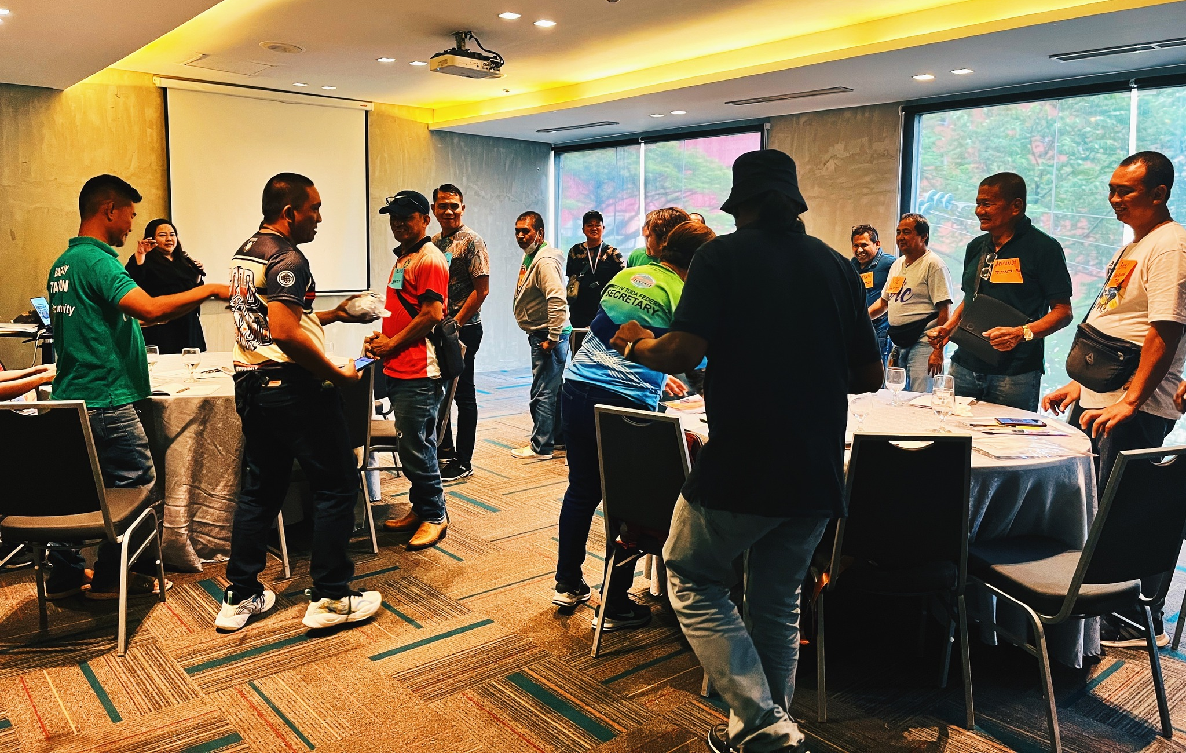
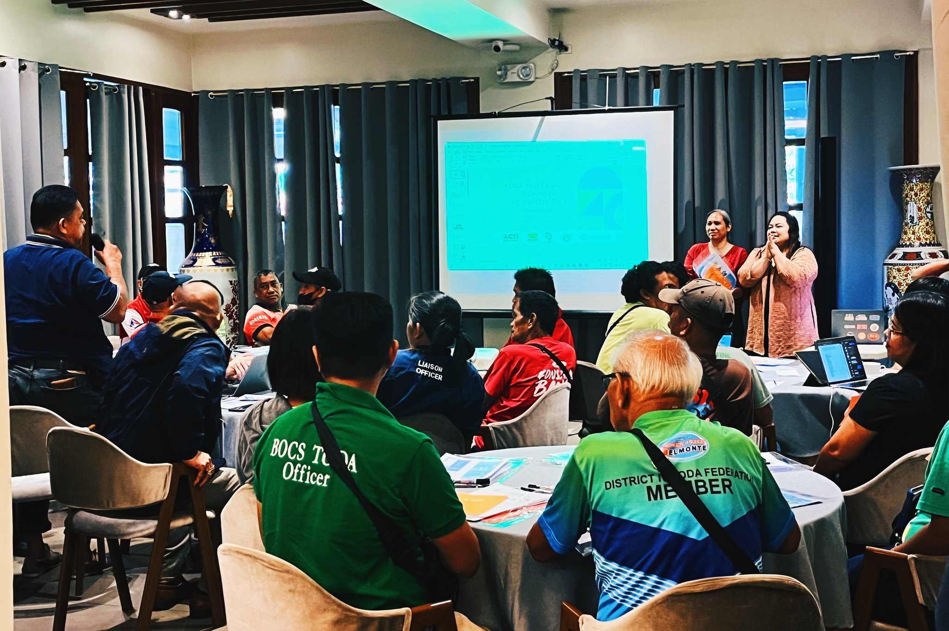
Peer Educators Training Day 1
Batch 1: March 17
Batch 2: March 18
ACTIVITIES
Backgrounder
Lessons on TB 101, COVID-19/PPR and QnA
Roles of a Peer Educator
Review of Lectures
Brainstorming on possible questions
Assignment for Day 1

Slide 8
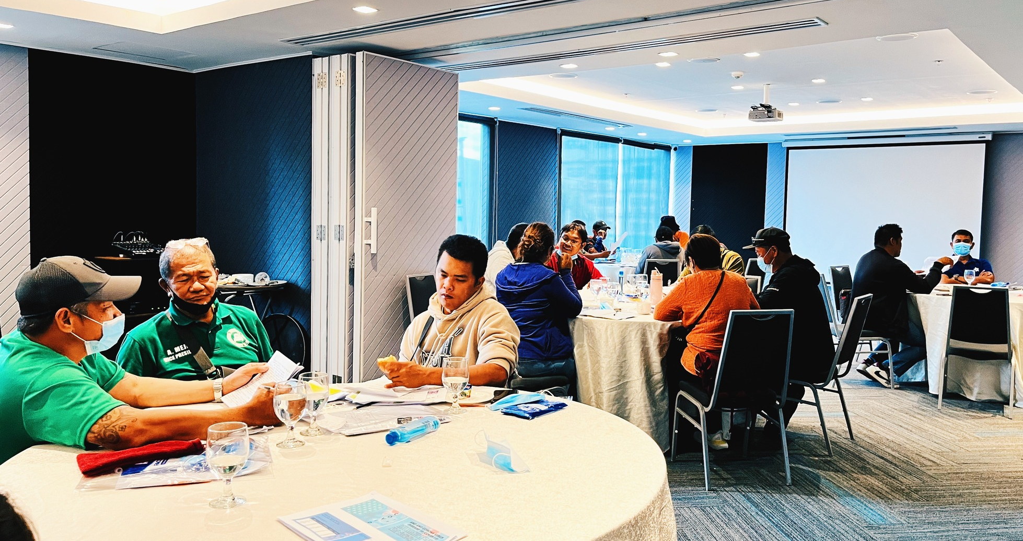
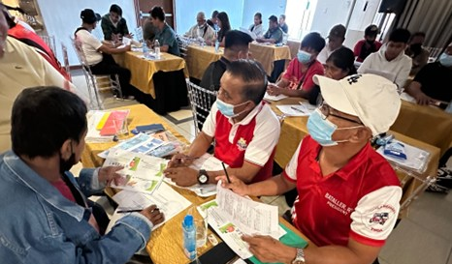
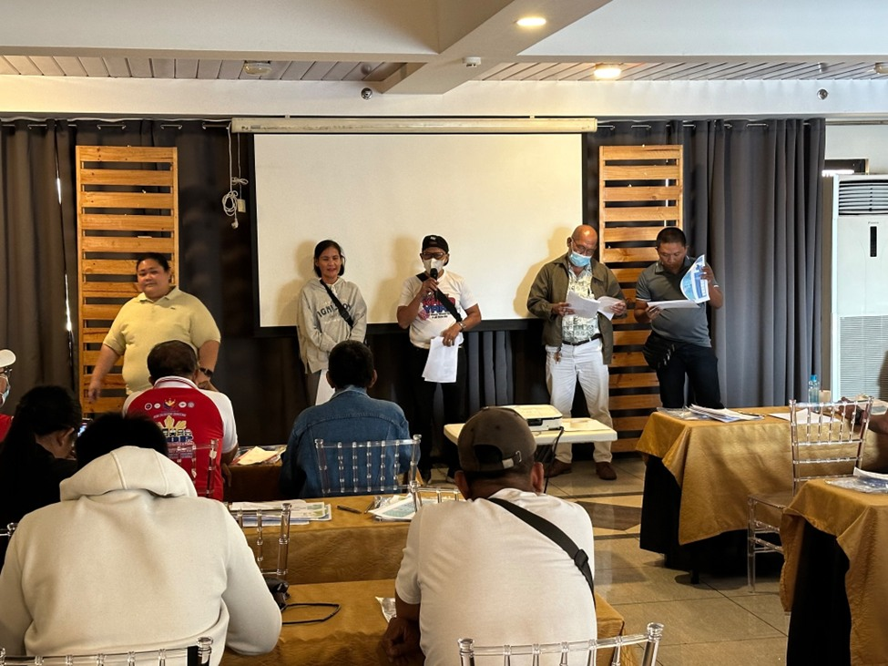
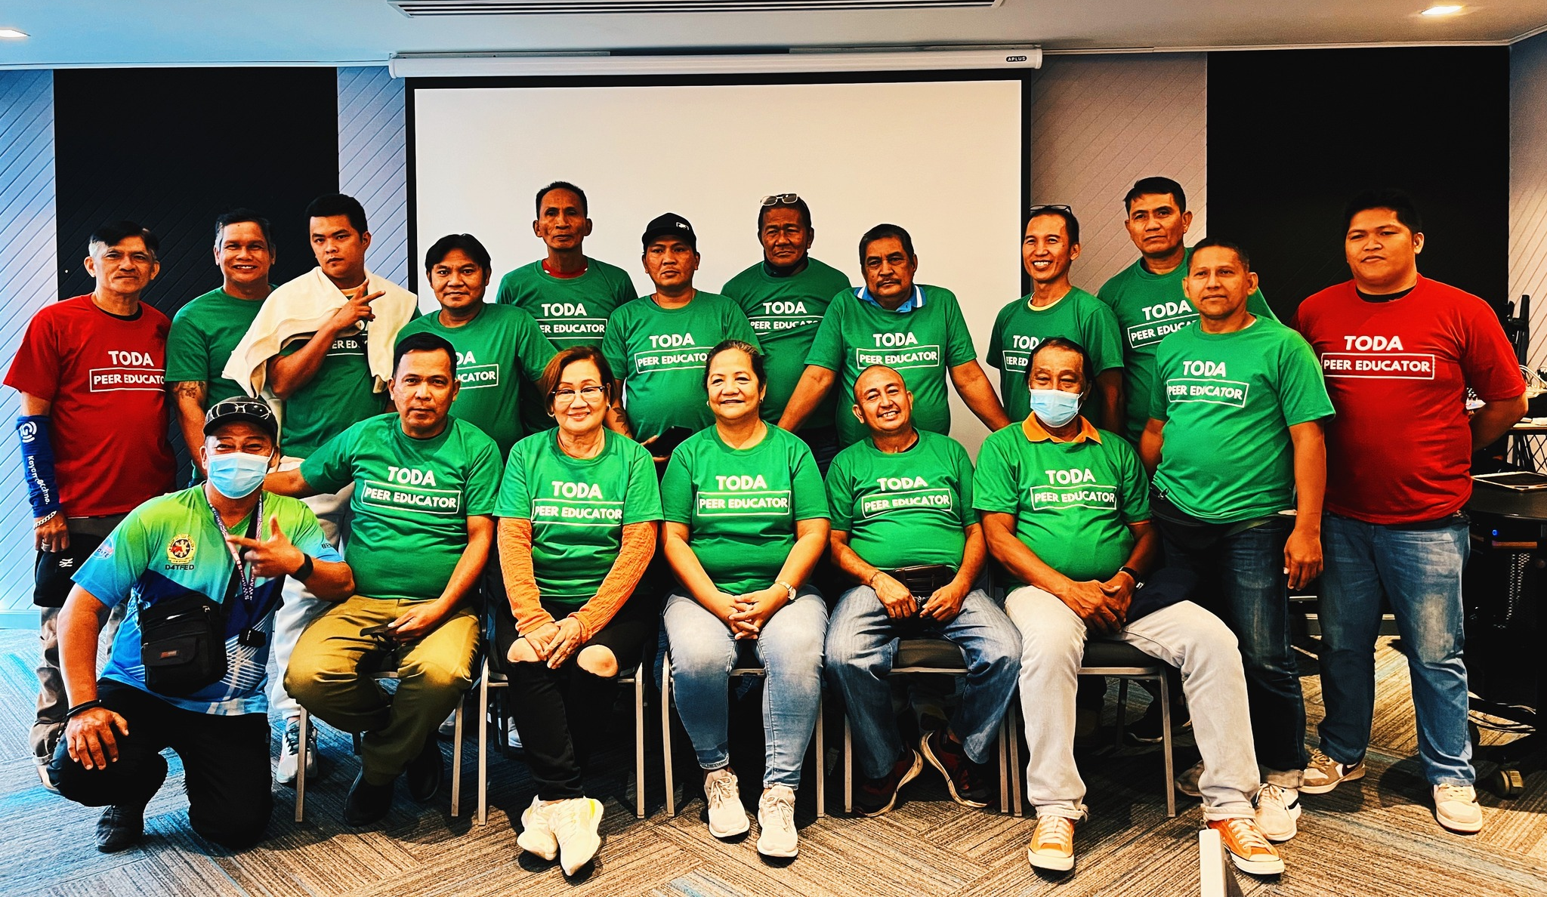
Peer Educators Training Day 2
Batch 1: March 23
Batch 2: March 24
ACTIVITIES
Day 2: March 23
Recap of the Previous Day/Session
Review of Lectures
Return Demonstration and Feedbacking (Assignment: Prepared script)
Monitoring (Attendance sheet)
T-shirt and materials distribution
Awarding of Certificates

Slide 9
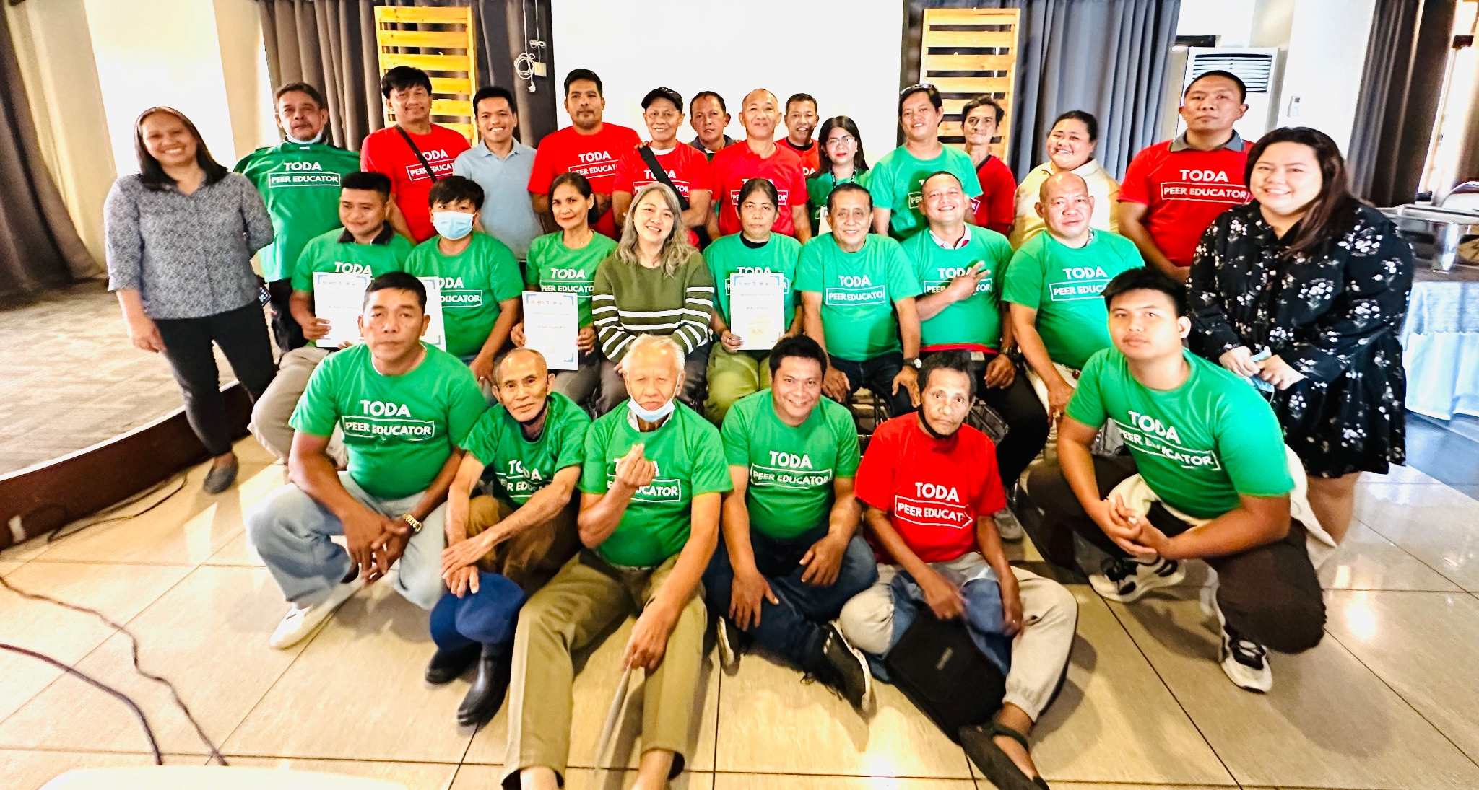
Training of TODA Peer Educators
Batch 1 and Batch 2 TODA Peer Educators Training Completers

Slide 10
Objectives of the Capacity Building
Enhance the knowledge of the participants about TB and COVID-19/Pandemics.
To empower the participants, and recognize their role in engaging in TB and COVID-19/Pandemic programs by providing them with the necessary skills and tools to facilitate their work as peer educators
To support TODA Peer Educators in reaching their peers and share their knowledge on TB and COVID-19/Pandemics.

Slide 11
Roll-out of information dissemination by TODA Peer Educators
Notes:
Each of the TODA trained are targeting 20 other TODA members to share their knowledge. With 50 target TODA peer educators, we are expecting around 1000 TODA members to be reached.

Slide 12
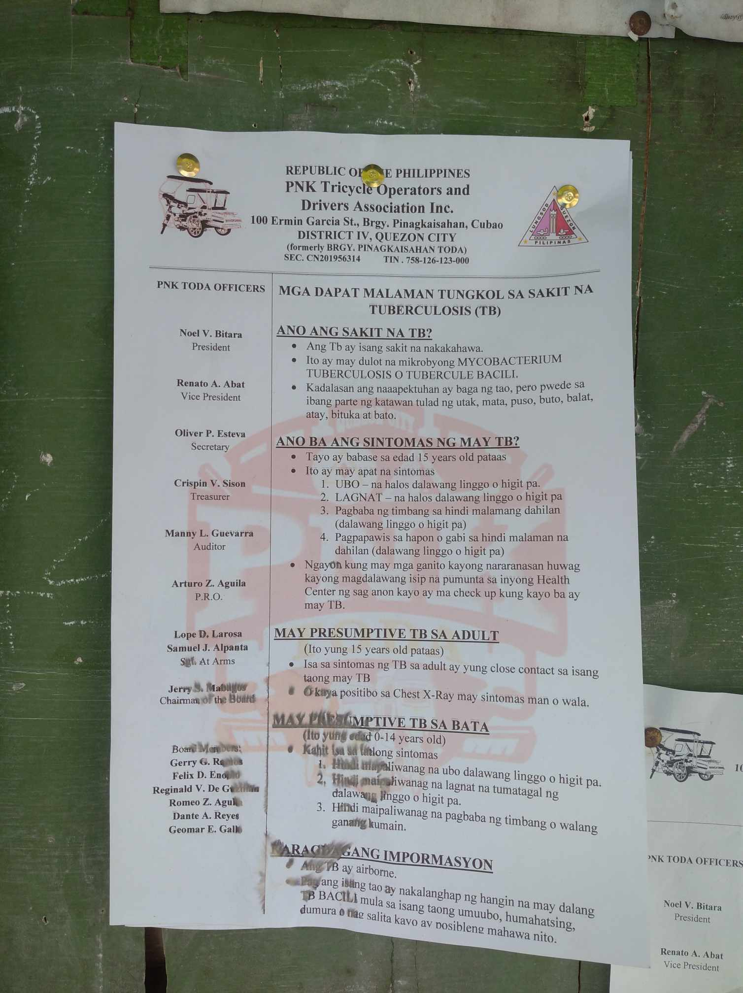
Roll-out of information dissemination by TODA Peer Educators
TB-COVID-19 information posted on the terminal’s bulletin board

Slide 13
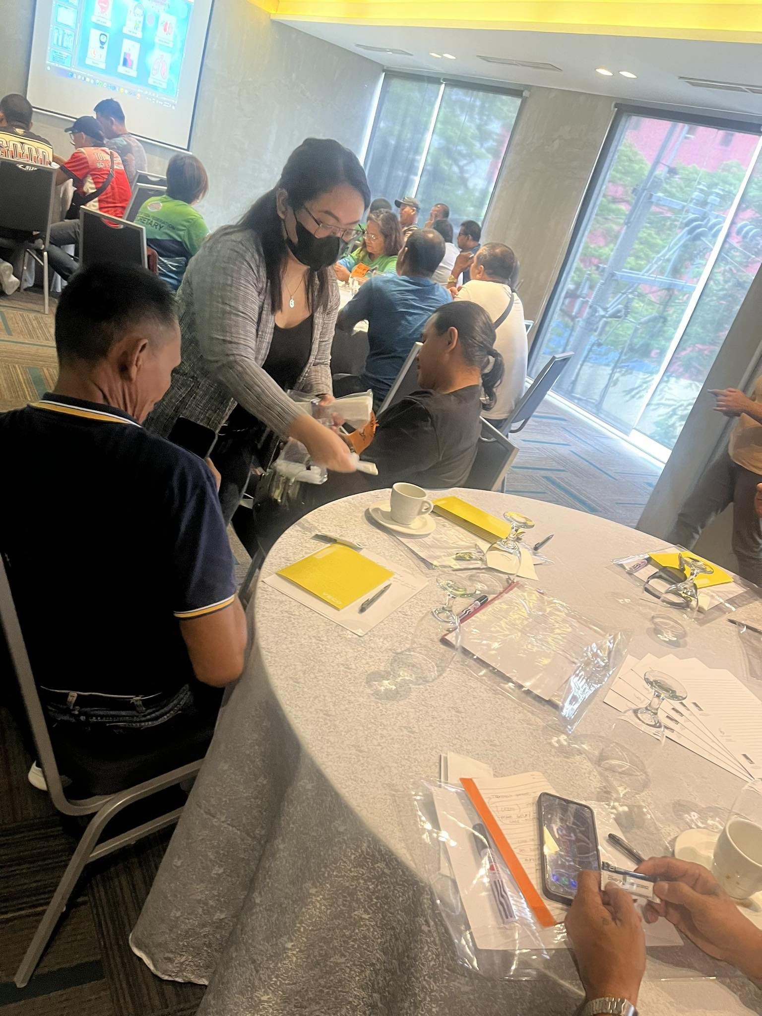
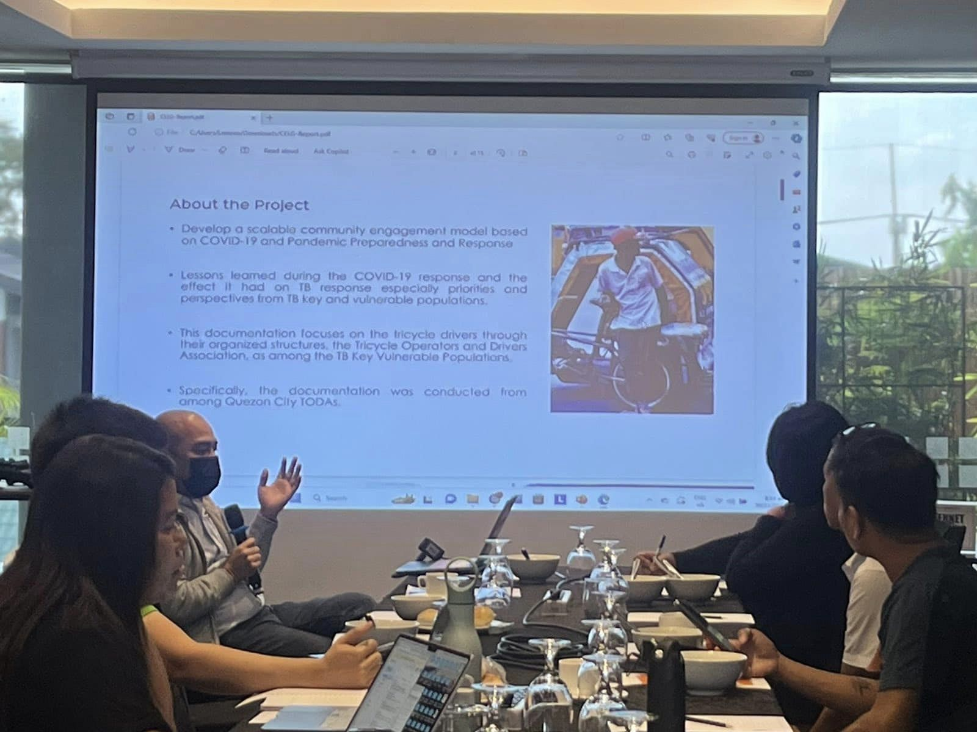
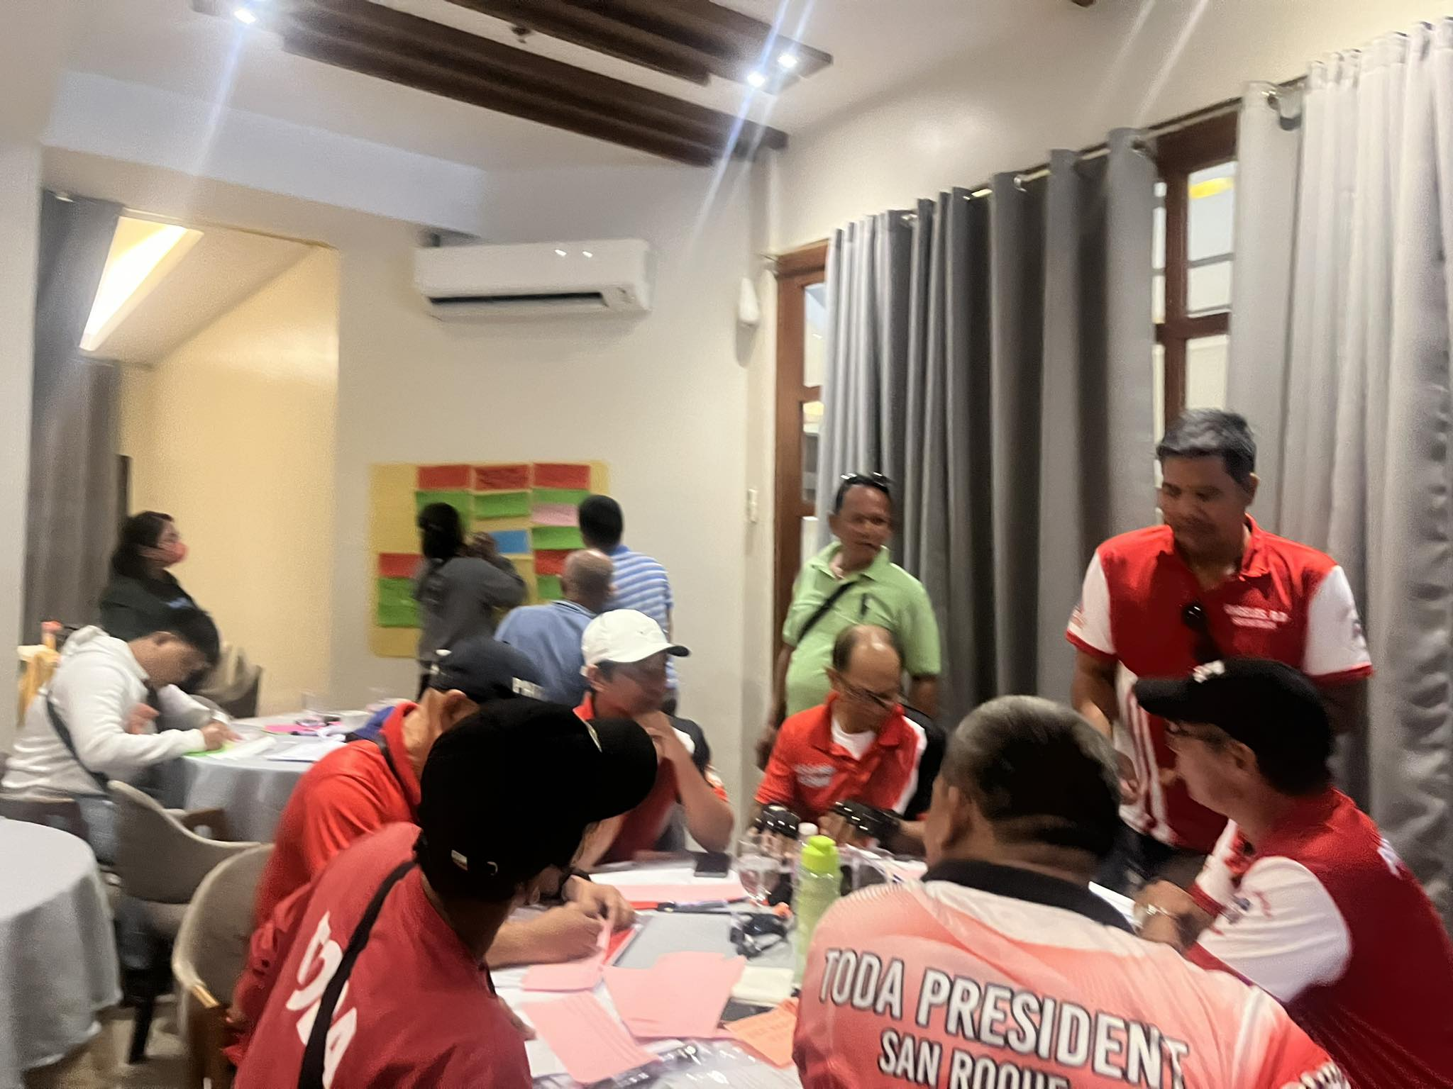
Lessons Learned

Slide 14
Locating LMPs
As daily wage earners, they are always busy and cannot find time to reply to messages or calls.
To gain their trust, consistent communication and reaching out are essential. Meeting them at their place of work, such as TODA terminals, significantly boosts their participation in the project.
Mobilizing LMPs
It is difficult for TODA to participate in community or health-related activities due to them being daily wage earners.
From planning to the capacity-building activities, most of them have raised the importance of support or incentives such to ensure their smooth participation in similar programs.
The presence of representatives from the government sector, NGOs, and support group members of the Philippine Alliance to Stop TB helped boost the morale of the TODA groups. Their participation in the activities showed that they support improving the quality of life of the TODA community.
Building their capacities
Members of the TODA community can become effective peer educators and leaders with proper training, suitable materials, sustainable support, and motivation.
Openly discussing TB-related stigma and discrimination has made some TB survivors become more open and speak about their experience.

Slide 15
Recommendations
When engaging with the TODA community, it is crucial to recognize their important role in the project and the response. In the same way, they have to know and be shown that they are the key players.
The project and its partners need to support TODA in achieving the vision of a well-engaged TODA community in decision-making platforms for health, TB, PPR, etc. This involves empowering the community to identify their needs, determine how to access those needs, and decide what kind of assistance is required and who and where to turn to for help.

Slide 16
Recommendations
Capacitate and empower potential TODA champions to create a strong voice within the community and to enable them to also empower their communities.
Expand and train more TODA Peer Educators and other transport workers e.g: Pedicab (Padyak), Jeepney, bus drivers, etc.
The engaged TODA members expressed interest in joining the Philippine Alliance to Stop TB/network of organizations working on TB. PASTB can explore how a multi-organized group can be represented in PASTB and other decision-making platforms.
Introduce the CLM mechanisms in the country, eg. CallKaLungs TB Community Hotline to gather feedback related to TB and other health services.

Slide 17
Thank you!

