Slide 1
Lesson Learned: Advocacy Efforts to Include the LMPs in the National TB & PPPR Priorities
Country name: Cambodia
Organisational Implementer: Khmer HIV/AIDS NGO Alliance (KHANA)

Slide 2
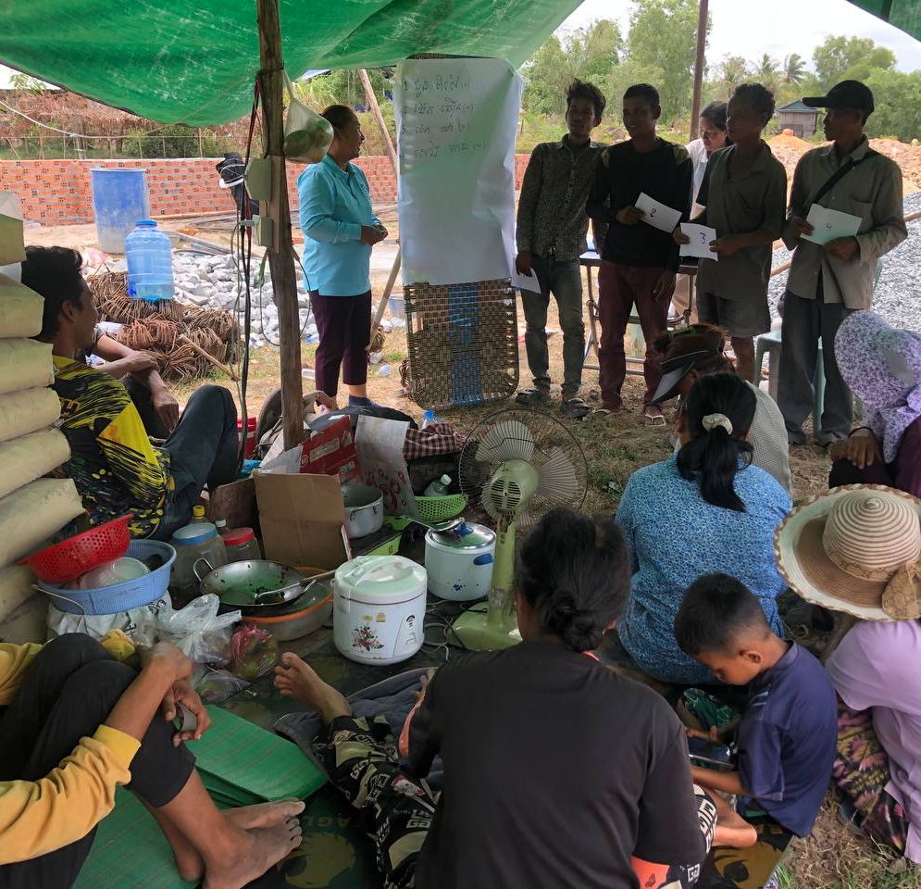
Background of the Last-Mile Population
Based on the key findings from the community engagement assessment, the TB key and vulnerable populations (TB KVP), such as elderly people aged 55+, PLHIV, people with chronic diseases (diabetes, high blood pressure), TB households, migrants, and people living in close settings, are almost left behind in terms of TB and COVID-19.
Other populations who are left behind by TB programs are construction workers (especially people working with painting substances), people living in slum areas, and other congregated settings.
The affected by TB (KVPs and construction workers) have recognized themselves as vulnerable groups and faced TB infections, including COVID-19, because of their working conditions, working environment, and TB service availabilities.

Slide 3
Community Engagement Plan and interventions
In responding the assessment results, the community engagement plan was developed to strengthen meaningful engagement of key and vulnerable populations (KVPs) and last-mile populations (LMPs) in the TB and PPPR response.
The community engagement plan has specific objectives as below:
Objective 1:
Inclusions of the TB KVPs and LMPs in TB networks
Objective 2:
Capacity building of TB KVPs and LMP Representatives
Objective 3:
Advancing stakeholders’ engagement for advocacy-related LMPs
Objective 4:
Addressing social barriers, including legal and mental health barriers

Slide 4
Community Engagement Plan and interventions (cont’)
There were numerous selected activities from the community engagement plan to be implemented for advocacy purposes:
Organize advocacy meetings to raise awareness and sensitize high-level government officials and key stakeholders on the need for integration and participation of LMPs into the TB and PPPR response.
Organize sessions or meetings to facilitate the inclusion of the LMP as key members of the current TB networks.
Discuss and assign specific focal point(s) responsible for supporting the TB representatives to engage in technical meetings.
Conduct advocacy training for TB champions and TB community leaders to be ready for running policy and practice changes to reduce discrimination, and to promote equal access to services.

Slide 5
Key results from the selected intervention implementation
TB KVPs and LMPs
Sensitization Meeting among high-level officials
(Delayed)
Inclusions of LMPs into the existing TB networks (TBpeople Cambodia)
(Coordination meeting was conducted with 54 participants joined)
Recruit the representatives of LMPs
(Established 24 PSGs and registered 388 members)
Capacity-building training on basic knowledge of TB, PPPR, and LMPs
(Training was organized with 41 participants from TB KVPs and LMPs representatives)

Slide 6
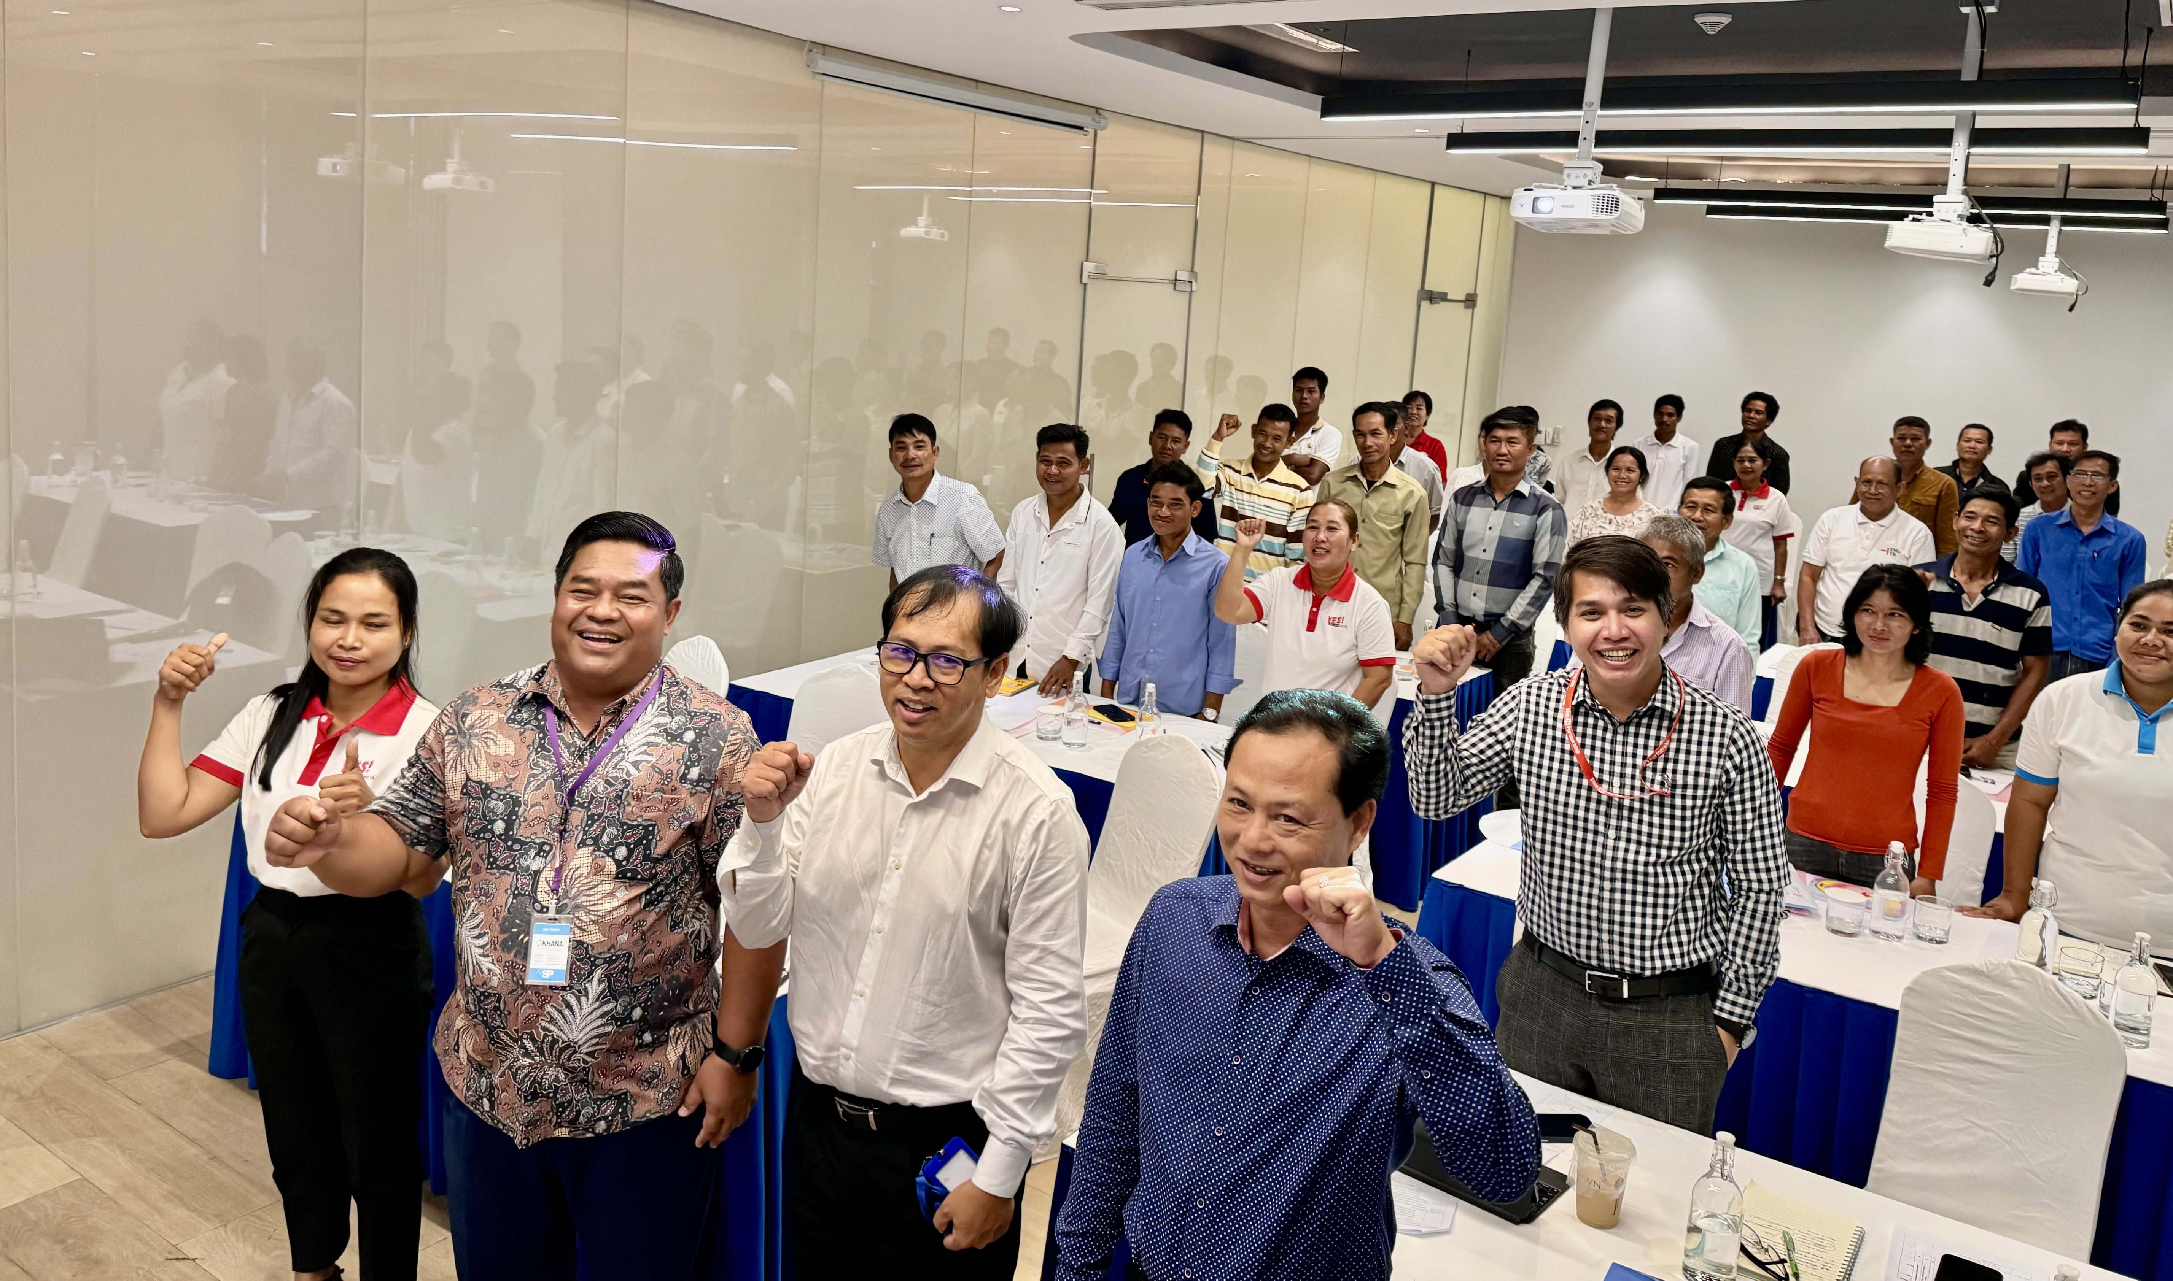
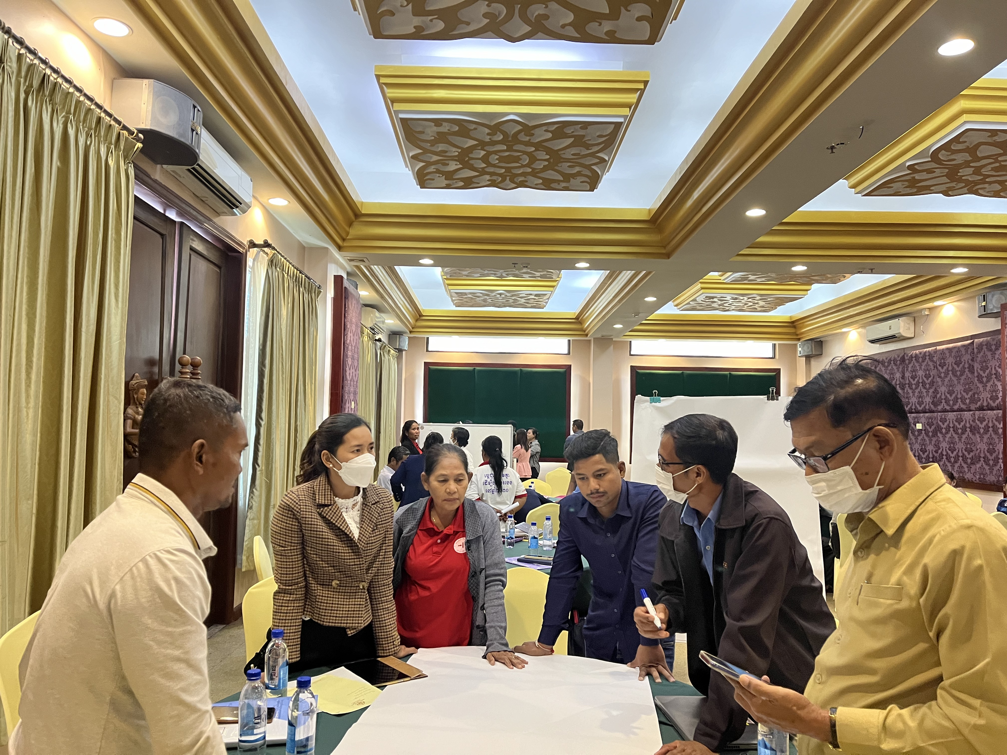
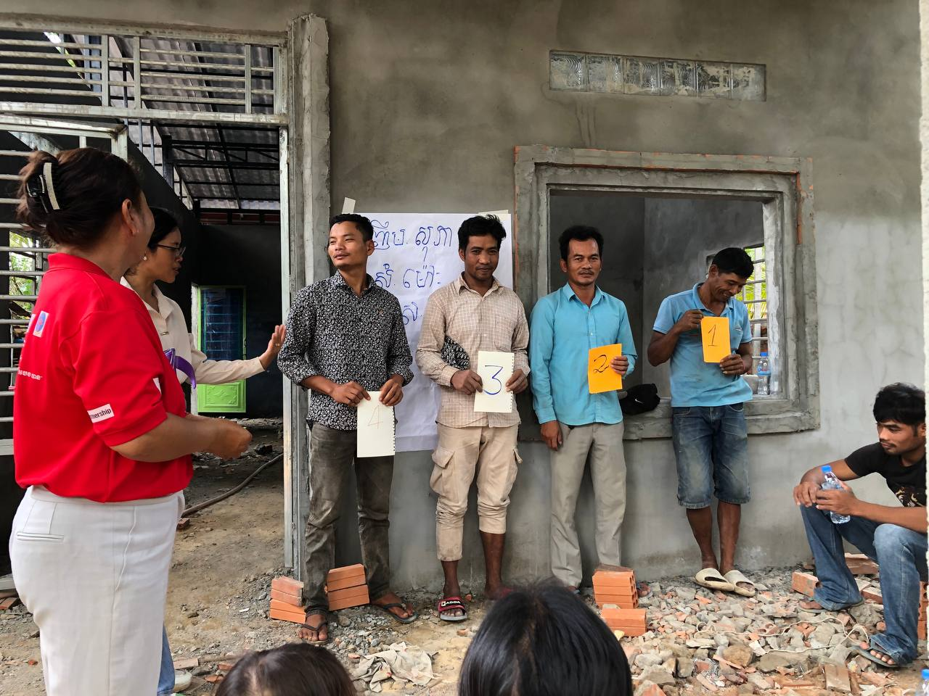
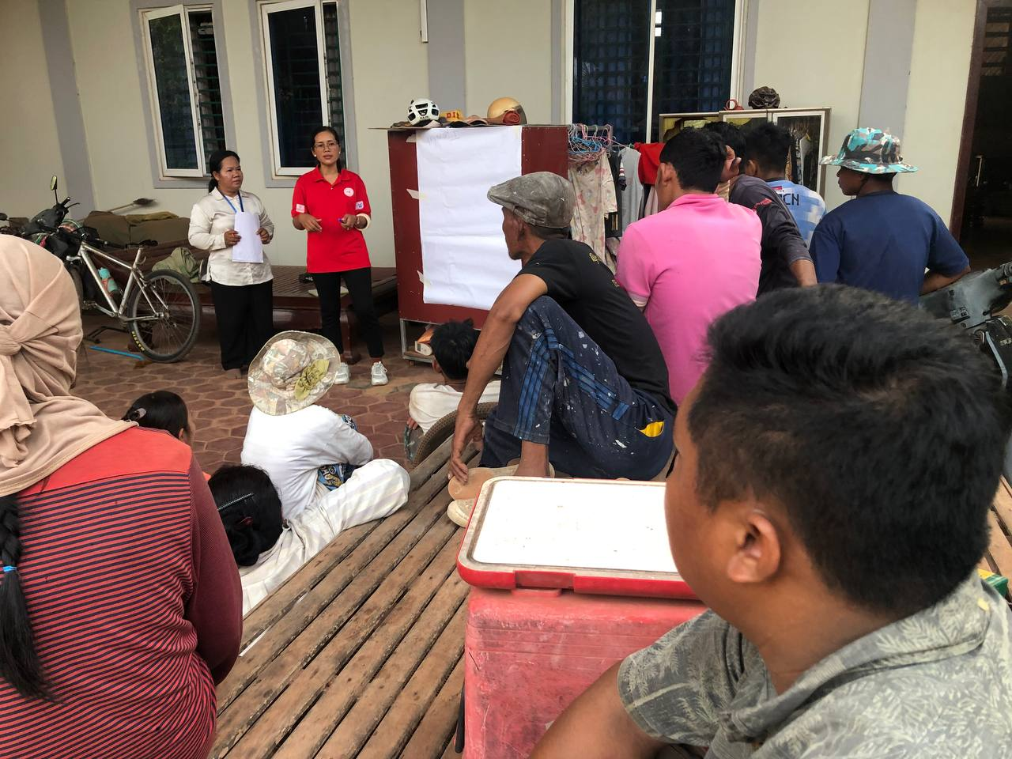

Slide 7
Lessons Learned
There were several major challenges working on advocacy for the LMPs, including:
Limitation of support and collaboration from local authorities (security reasons), construction owners (loss of productivity).
Timing barriers for gathering and consulting with construction workers.
But….
Strong support from the NTP, PHDs, and ODs, while engaging from chiefs of villages, village health support groups, and the existing peer support groups were mobilized the construction workers (LMPs) in the local areas.
Flexible times for meeting with LMPs from the program team.
Building partnership and networking with the existing TBpeople Cambodia, is strong voices to voice to advocate for the inclusions of LMPs at national level (NTP and CCC).

Slide 8
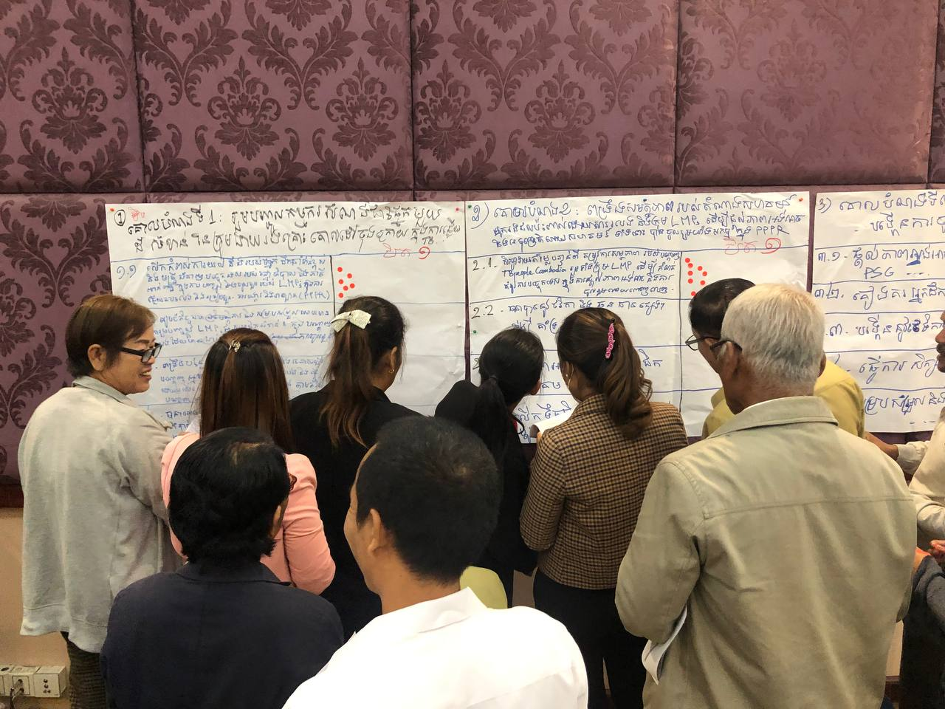
Lessons Learned
What other needs must the CELG address to expand in these areas?
Advance the engagement and empowerment of LMP representatives in TB and PPPR through capacity building (leadership, advocacy, effective communication) and exchange learning opportunities.
Provide technical and financial assistance to TBpeople Cambodia to produce a directory or guidebook for LMPs accessing TB, COVID-19, PPR, and other health-related services.

Slide 9
Recommendations
Expand the awareness and sensitization of LMPs activities amongst TB management and service providers at sub-national levels.
Implement specific initiatives to strengthen the enabling environment for the inclusion of LMPs, such as partnership dialogues, stakeholders’ engagement platforms, and so on.
Create a TB community partnership platform for promoting meaningful engagement of LMP representatives at national and sub-national levels.

Slide 10
Closing

