Slide 1
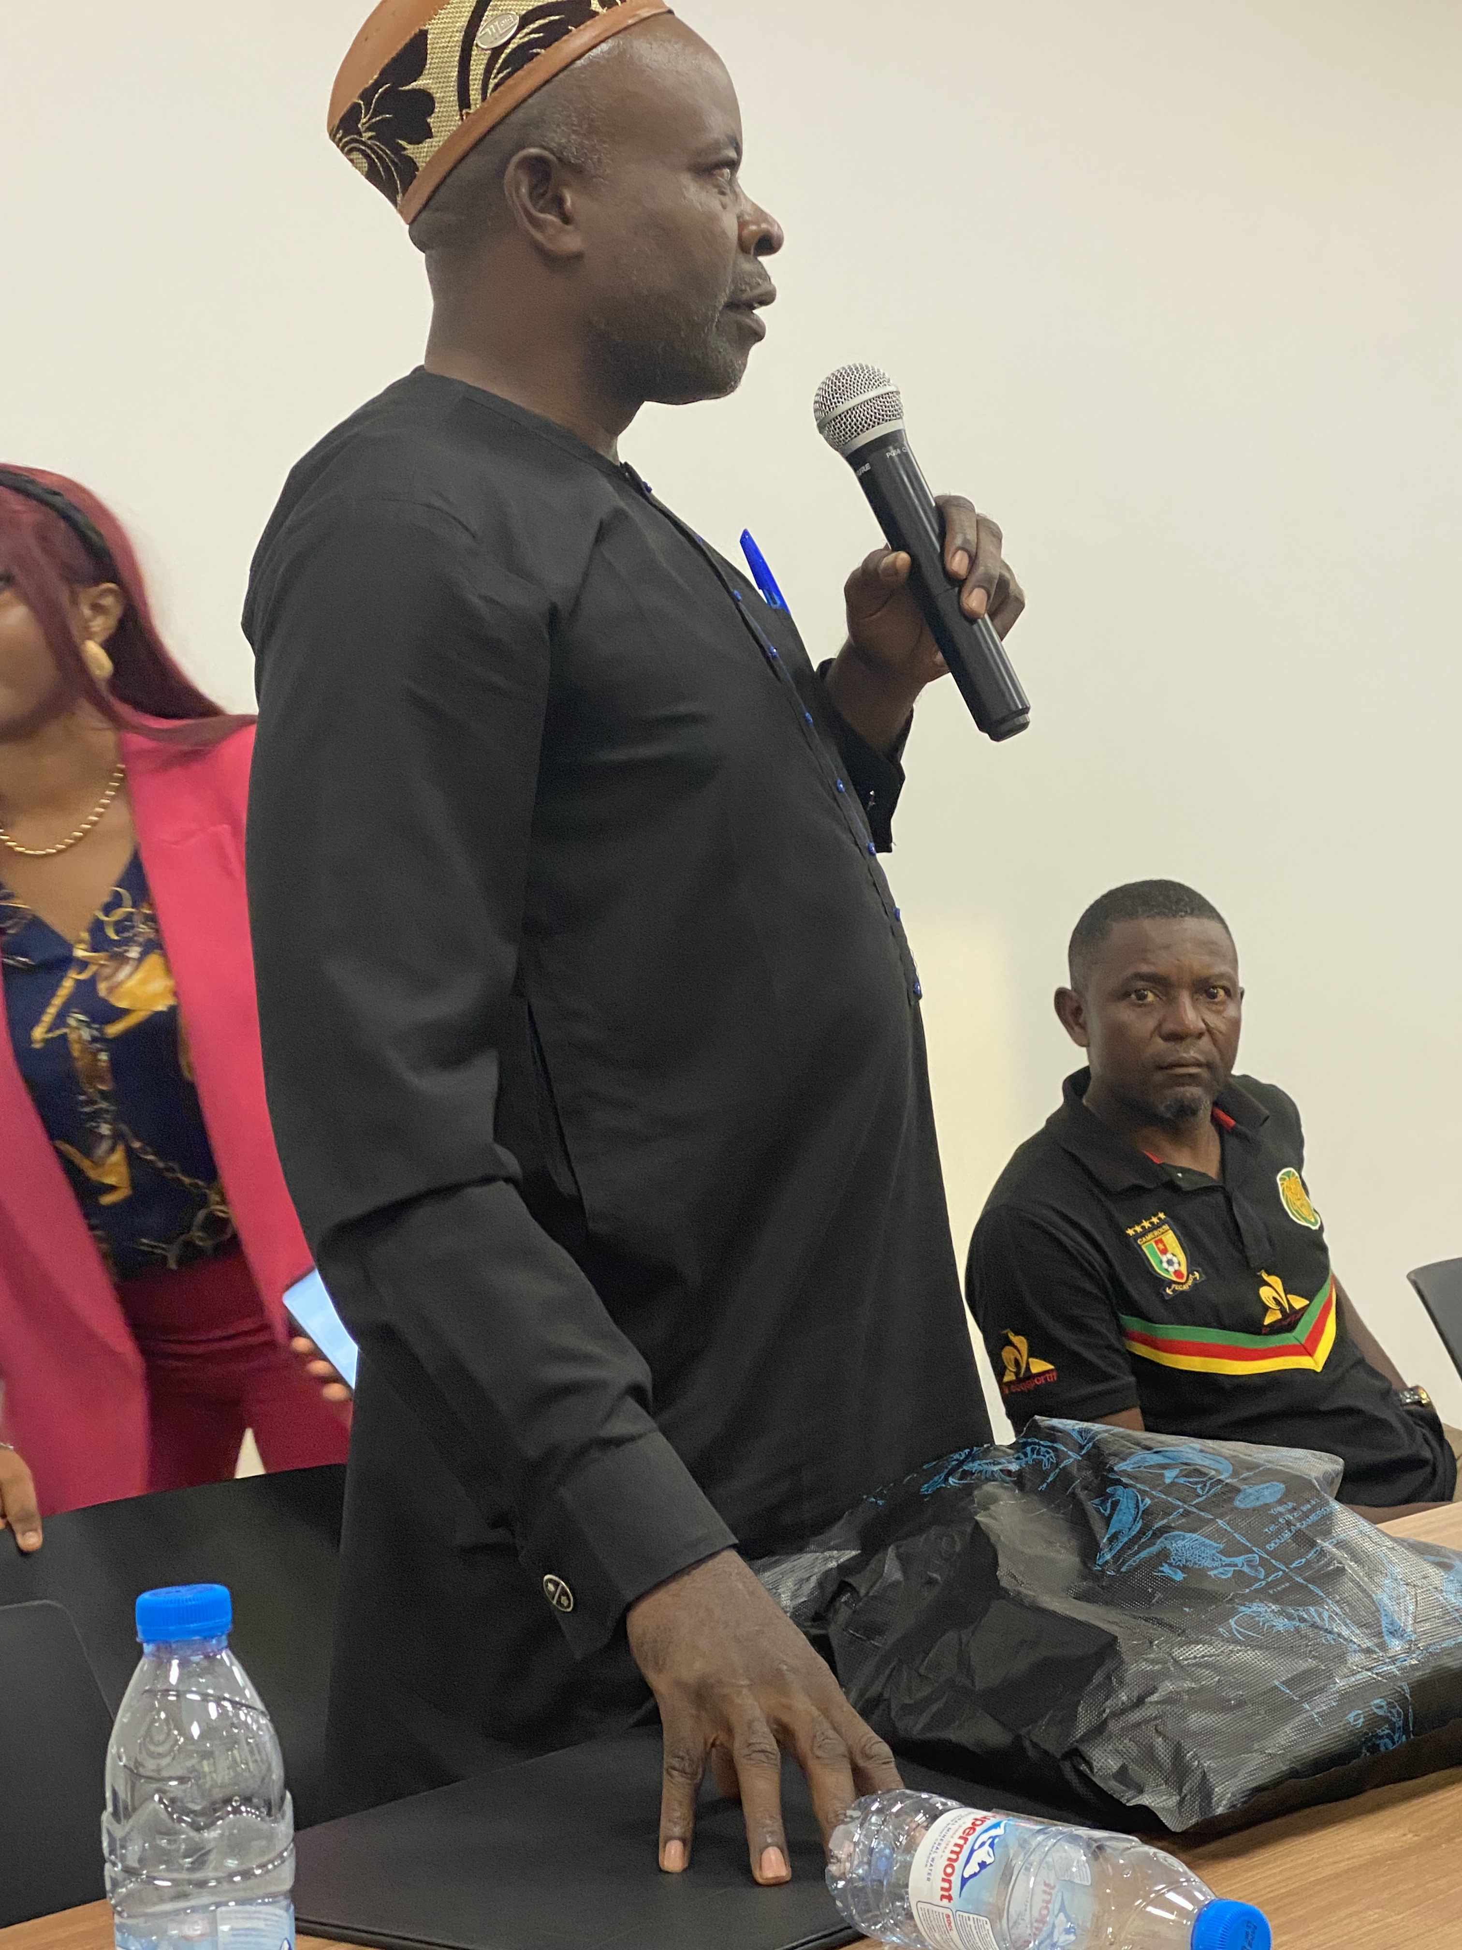




ENGAGEMENT OF IDPs ON THE TB, COVID-19 AND OTHERS PANDEMICS IN CAMEROON
Cameroon
For Impact In Social Health (FIS)
LESSONS IN ADVOCATING FOR THE INCLUSION OF LMPs

Slide 2

Background
About IDPs
The Anglophone Crisis in Cameroon is an armed conflict pitting the Cameroonian army against separatist groups in the two English-speaking regions of Cameroon - the North West and the South West (NOSO).
Since 2017, the conflict has killed more than 6,000 people and forced more than a million people to flee. The crisis is ongoing
Risks and vulnerabilities
Discrimination and exclusion
Stigma ;
Poverty ;
Limit access to basic health services ;
Trauma and psychological distress ;
Ignorance ;
Lack of communication ;
Language barriers;

Slide 3
Engagement and capacity of LMPs to engage in TB and PPR at country-level
Only 14.2% were aware of the existence of organisations for IDPs;
63.3% and 72.2% belonged to unregistered community groups and did not participate in the activities organised by the structure;
93.54% did not know that the NTP existed;
92.53% of IDPs stated that there was no consultation and/or feedback mechanism for the PPR;
More than 50% of IDPs said that they had not been informed and had not been able to collaborate in PPR activities.

Slide 4

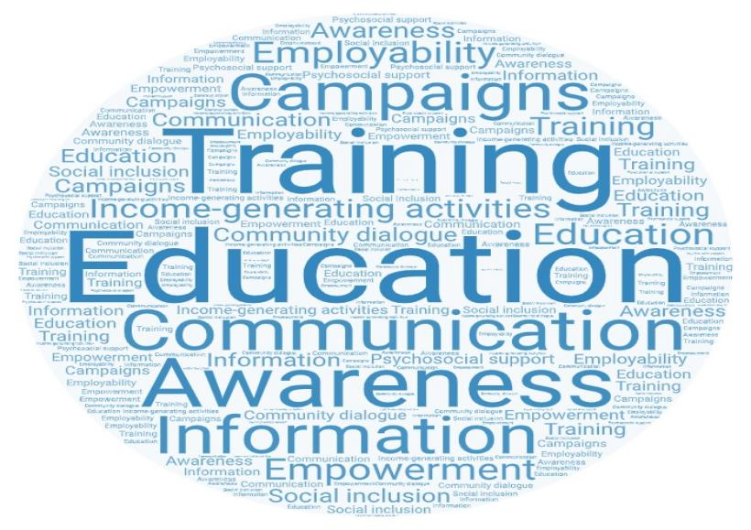

Challenges and barriers to community engagement in covid-19 and PPR
Main difficulties faced by last mile populations in engaging with Covid-19/PPR platforms
How can the above-mentioned challenges be addressed to improve last mile engagement in COVID-19/PPR?
What do you see as the barriers to last-mile community engagement in Covid-19, pandemic preparedness and response in your country?

Slide 5
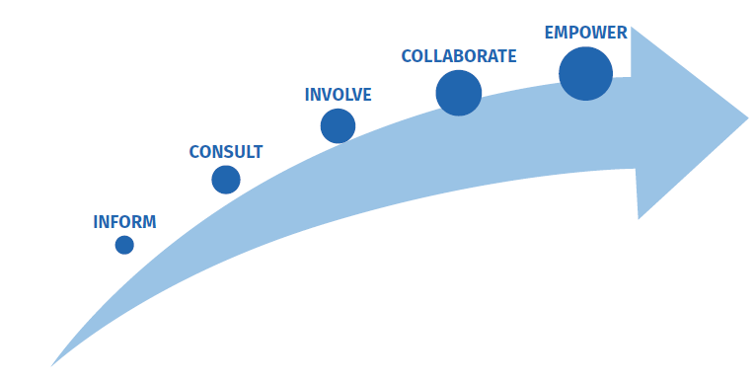
Community Engagement Plan and interventions
Key advocacy activities conducted
Multi-stakeholders meetings
Film production
OneImpact reach
Advocacy workshop for PPR
Trainings

Slide 6
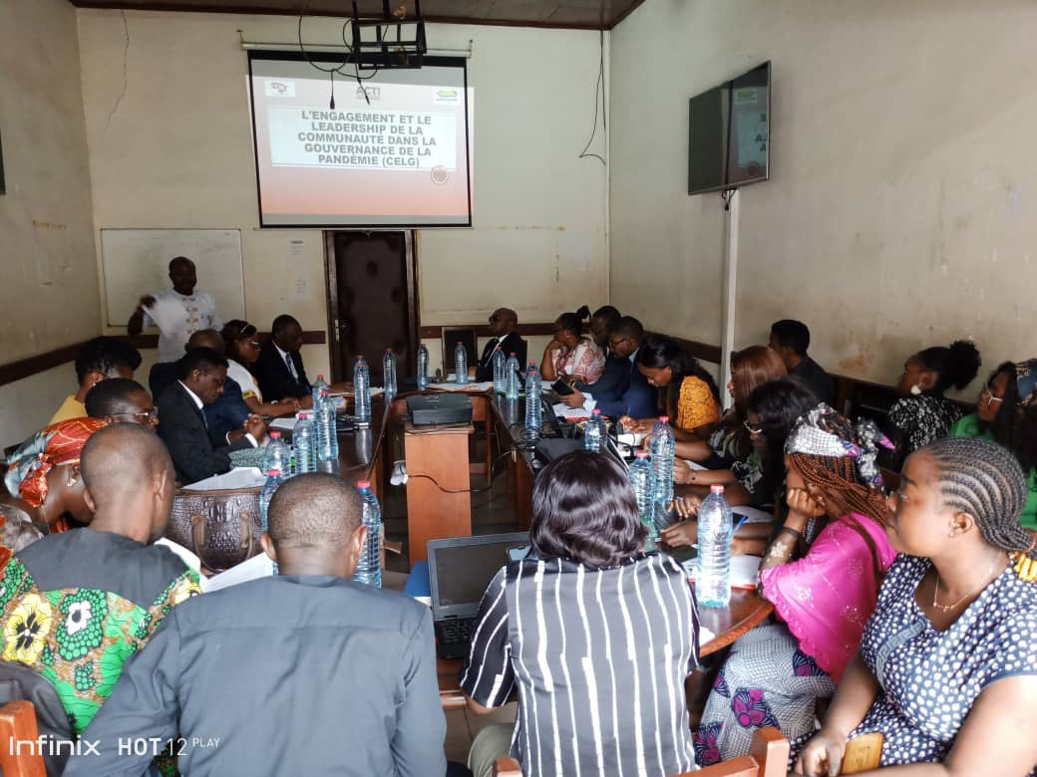
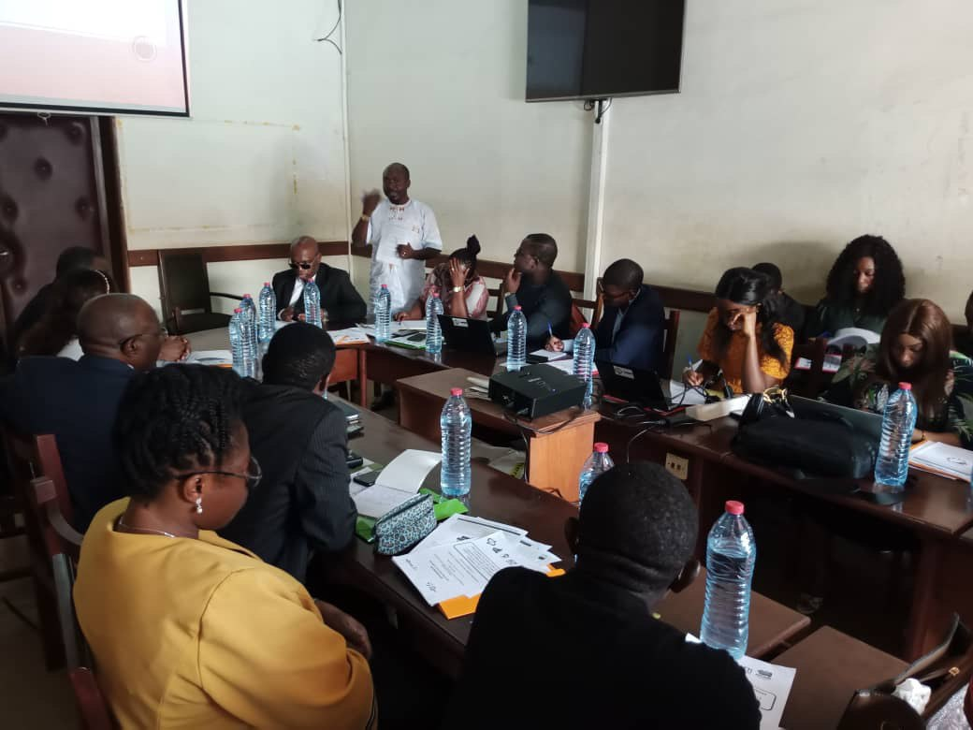
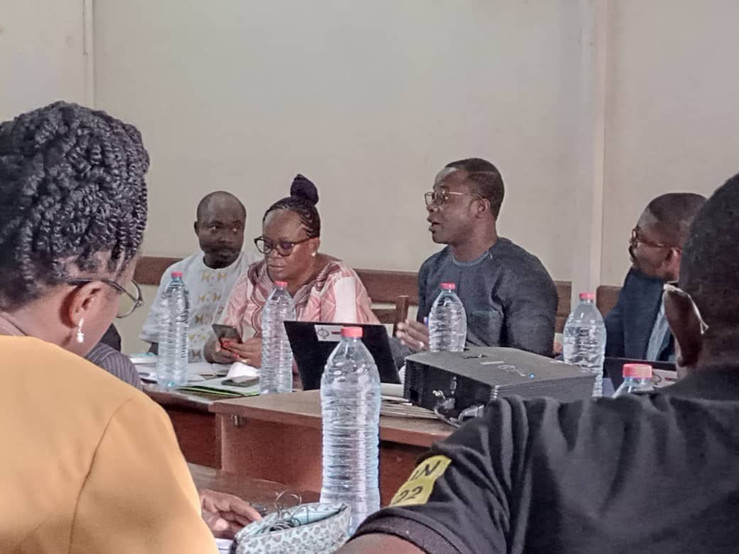
Inform
Meetings to mobilize stakeholders for Multisectoral Covid 19/ PPR Platforms including IDPs groups

Slide 7
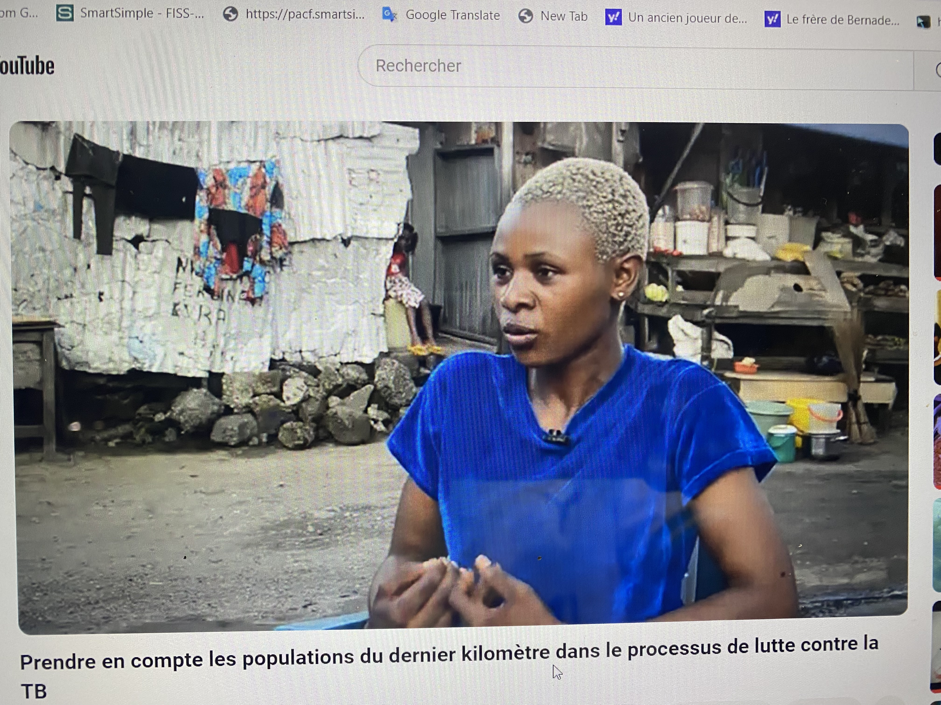
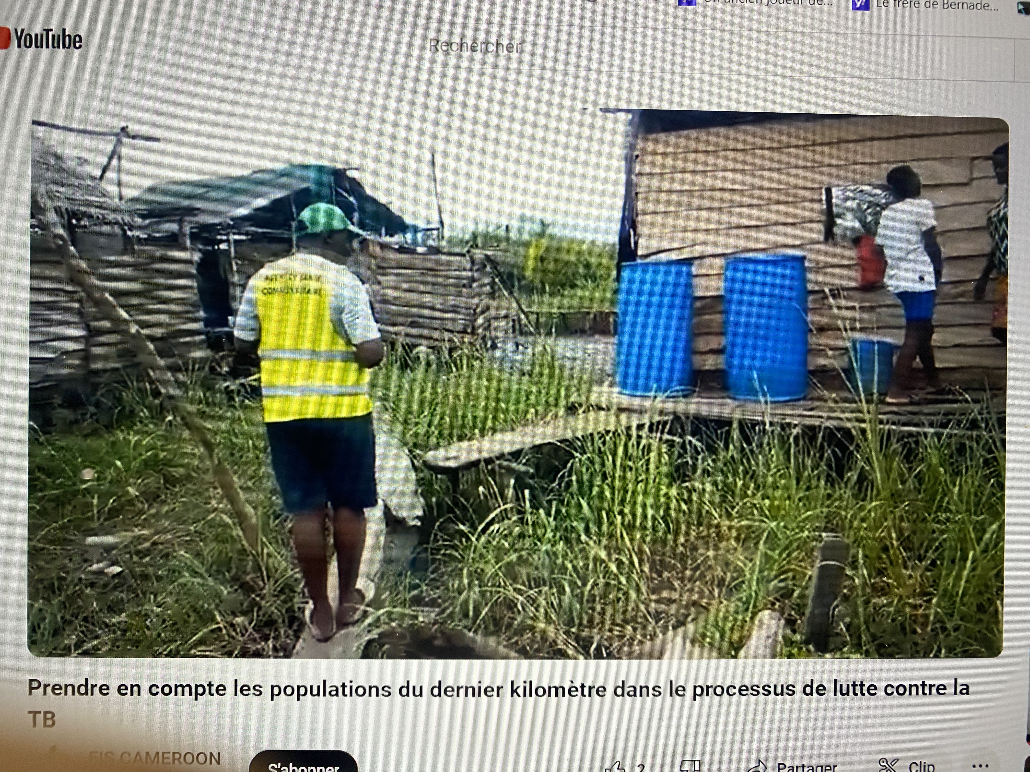
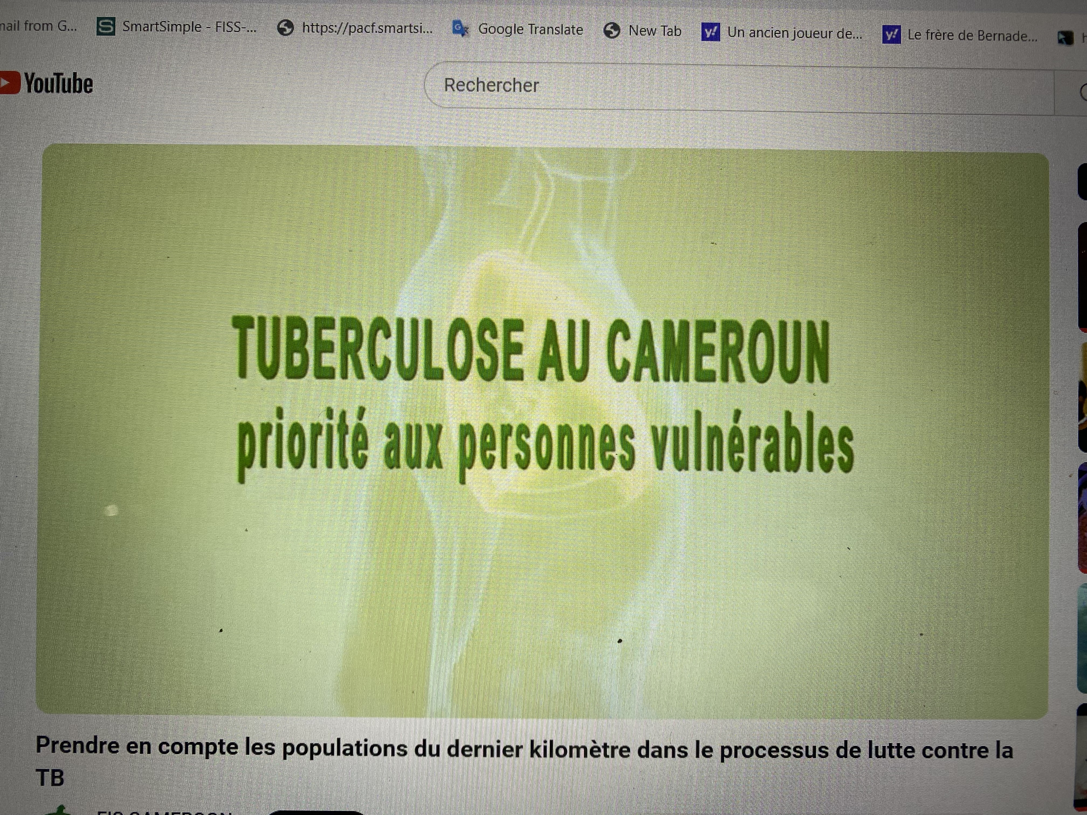
Consult
Production of 16 minutes documentary highlighting DPs keys needs such as social infrastructure, stigma, access to health services and support services
https://www.youtube.com/watch?v=A6hJgppIjhw

Slide 8
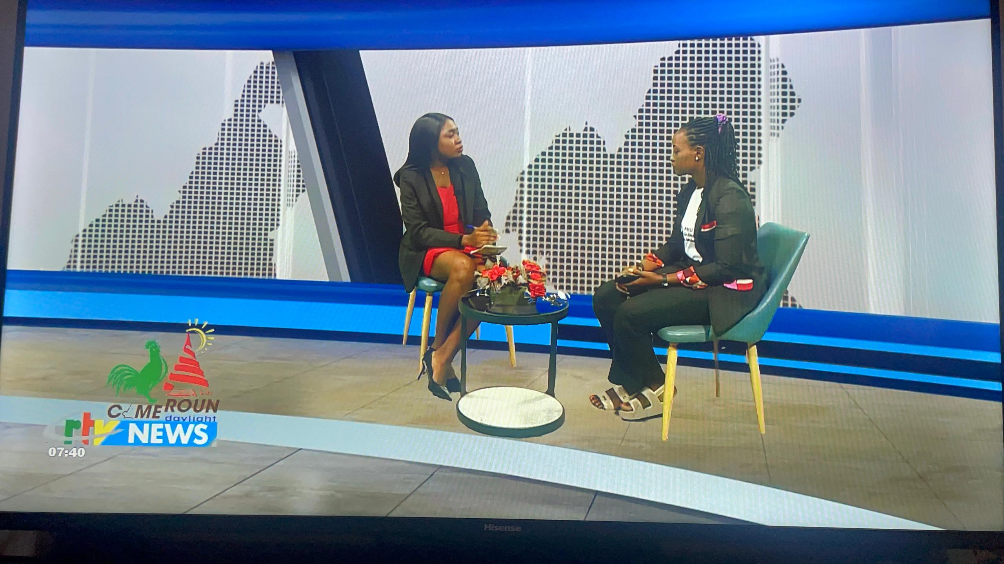
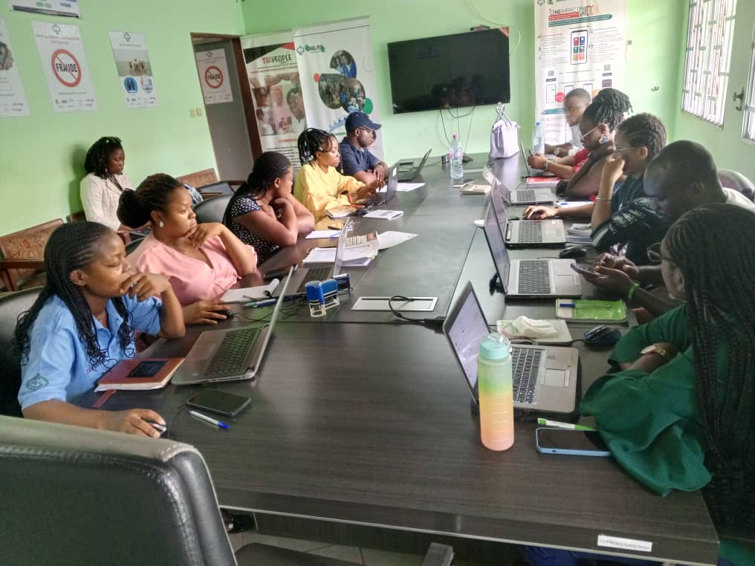
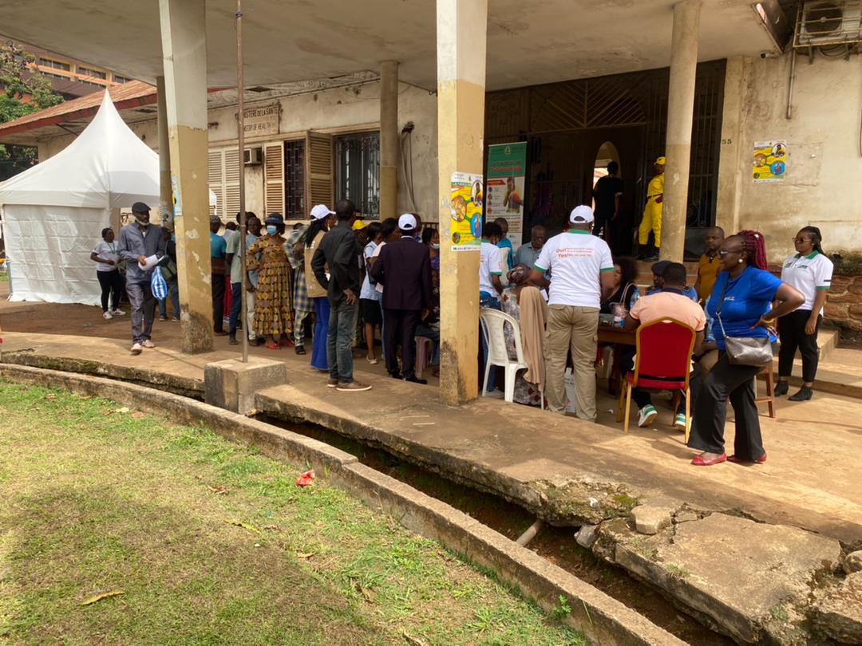
Involve
Engaged IDPs to use OneImpact to report challenges and barriers for services

Slide 9
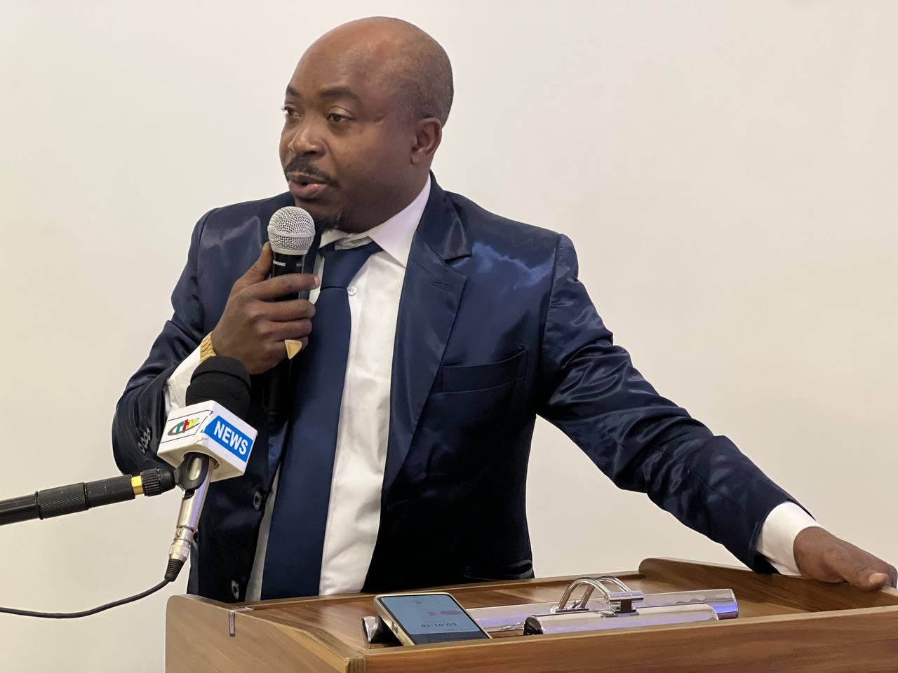
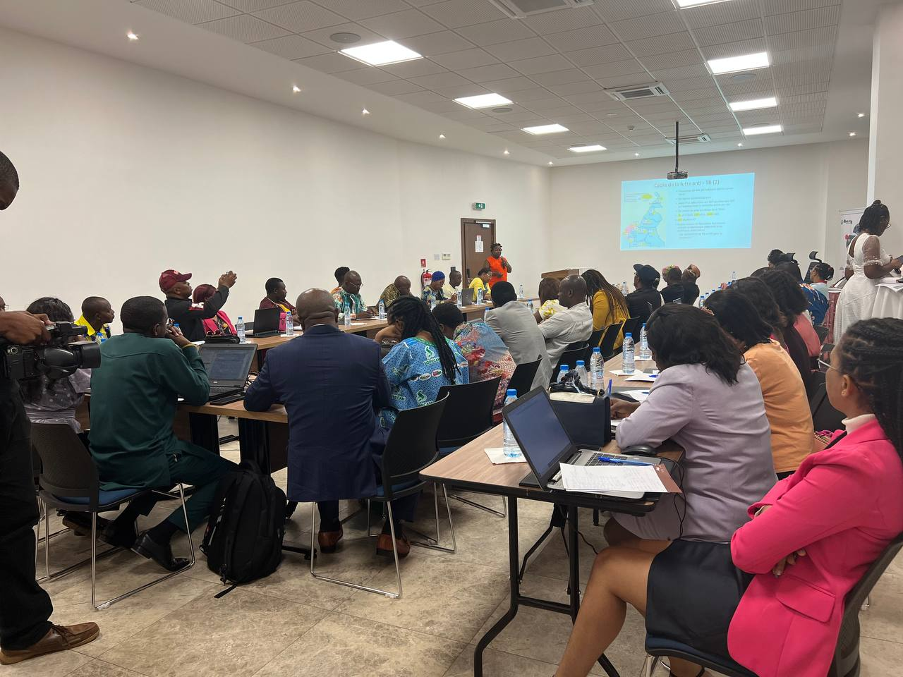
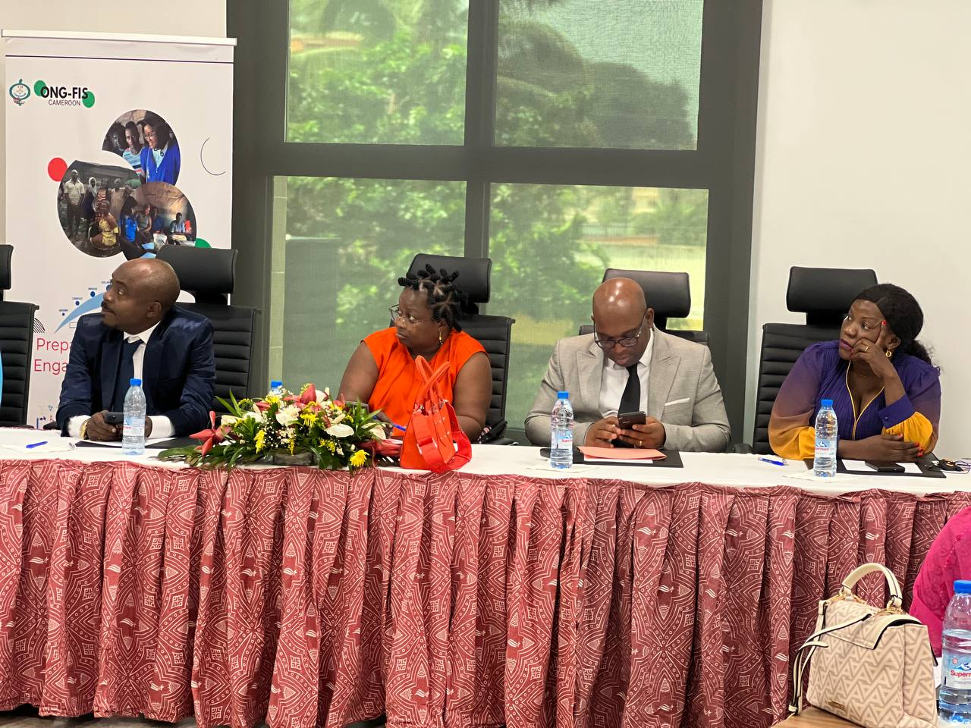
Collaborate
Advocacy workshop:
Preparing for Community Engagement in Pandemic Preparedness

Slide 10
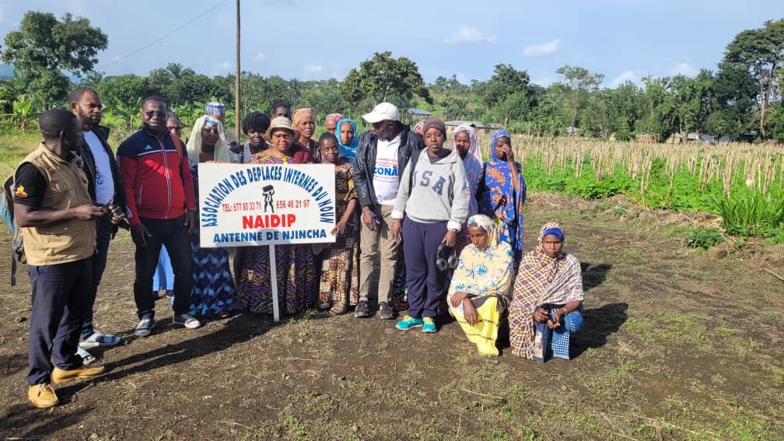
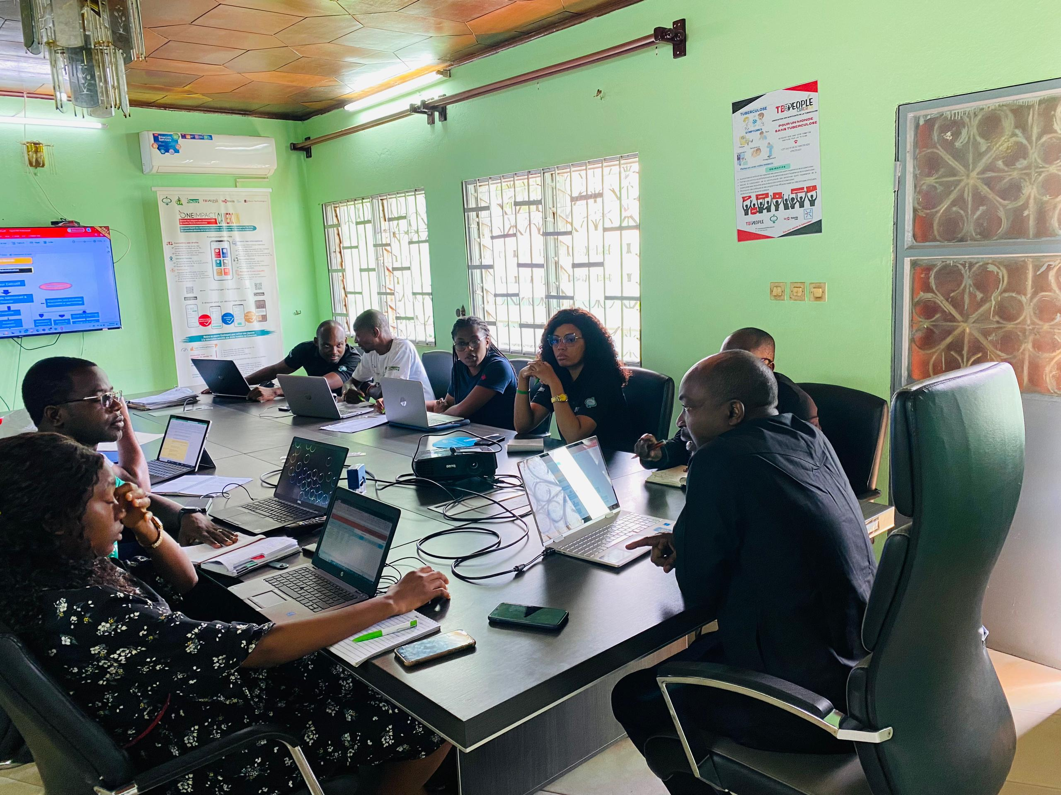
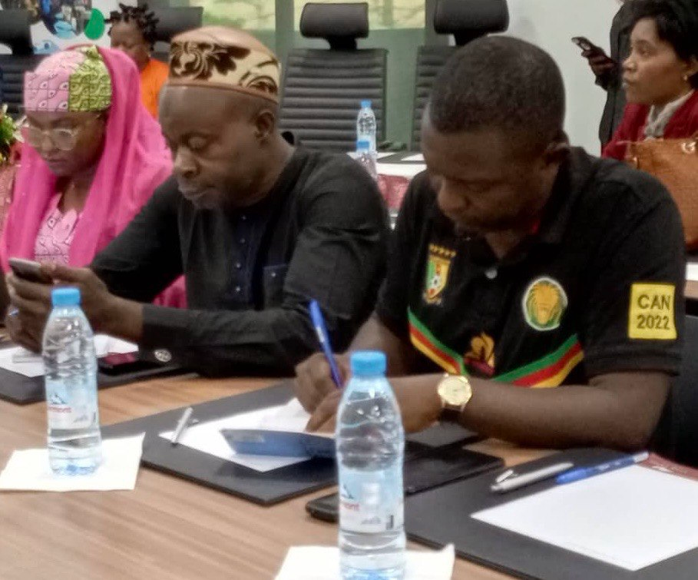
Empower
Capacity building and empowerment of 3 groups of IDPs in different cities of the country,

Slide 11
Linkages established between representatives and constituencies on various platforms
PPR Platforms formed
The 3 years’ COPPER CE country engagement plan validated.
Outcomes of advocacy activities

Slide 12
Access to information and a lack of accountability on the part of public bodies responsible for implementing state policies. The priorities of IDPs are more oriented towards subsistence.
IDPs have limited participation mainly due to discrimination, poverty, ignorance, lack of communication, and language barriers.
The limited participation of other partners such as other ministerial departments in charge of social issues and finance. The participation of major United Nations agents was also a handicap in the process.
Challenges

Slide 13
Rely on existing associations for the effective implementation of community interventions aimed at IDPs. They have human resources and already know the fied.
As a prelude to developing a communication plan accompanied by a media plan, it would be preferable to consider carrying out a study/analysis of “IDPs friendly” actors and stakeholders backed by a Knowledge, attitudes and practices study which will allow have key words, vehicle words from which awareness messages can be developed, tools reviewed or updated.
Strengthen collaboration between IDPs and other key stakeholders in networks, alliances and coalitions on aspects of the fight against TB, COVID 19/PPR.
Additional needs

Slide 14
Lead of the Ministry of Health: At the start of the process, the project leader (FIS Cameroon) organized several meetings with the different directorates of the Ministry of Health and the national tuberculosis control program. This made it possible to strengthen the leadership of the Ministry of Public Health throughout the process. .
Orientation for all the stakeholders: at the end of the orientation meeting, (i) the main national stakeholders became aware of the project objectives and the road map for the evaluation of community engagement;
Collaboration between stakeholders: through meetings, WhatsApp groups, workshops and ongoing exchanges.
Identification of quality leaders: This process made it possible to discuss with local municipalities to identify community leaders recognized by their own communities and local authorities. This allows us to have relevant contacts who can highlight the real problems of the community.
Promotion of community leaders: this process engaged community leaders in promotion activities such as (i) the production of a film, (ii) the support of several leaders for workshops and meetings in the capital. This has helped them to be even more active in their communities.
Establishment of links at the local level between associations and international NGOs. This made it possible to resolve some priority needs such as facilitating access to health care and providing nutritional support for certain cases.
Recommendations

Slide 15
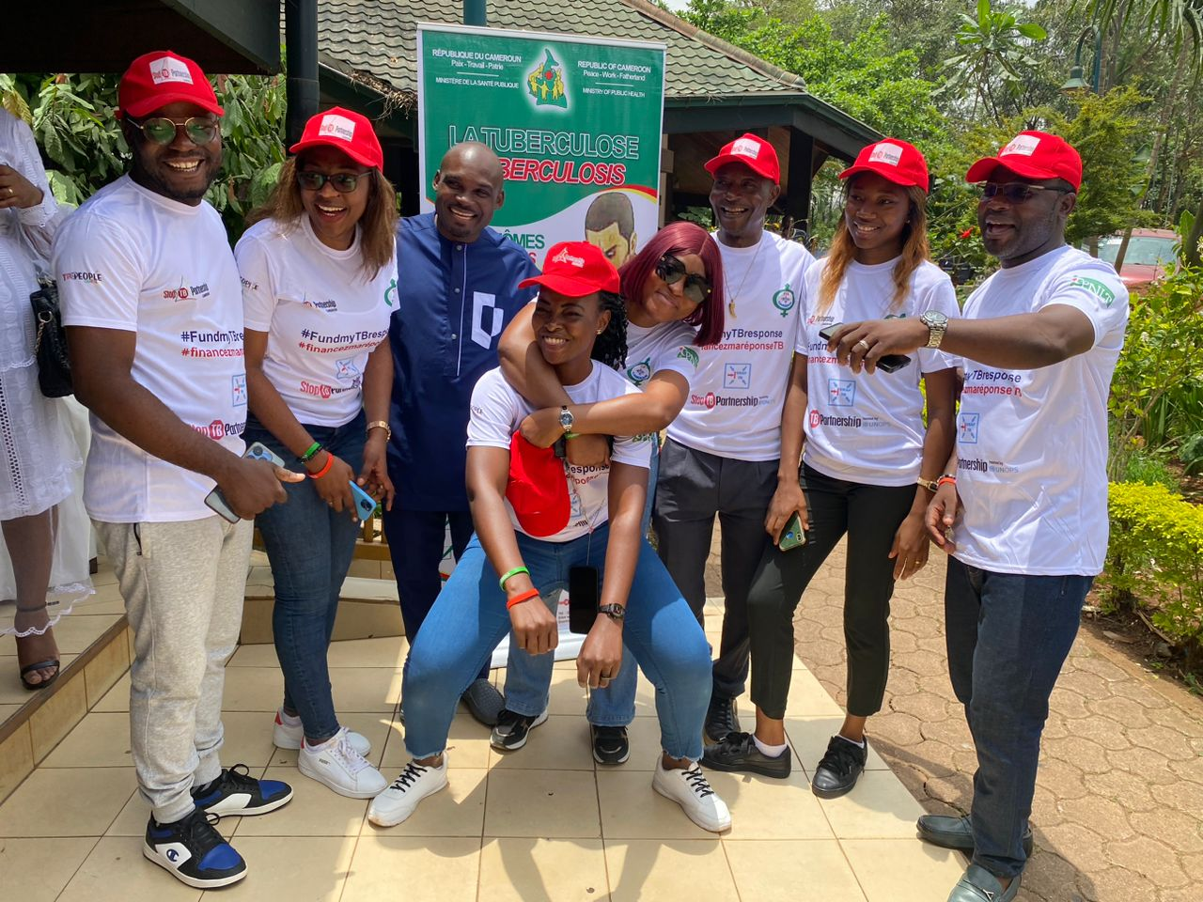
THANKS

