Slide 1
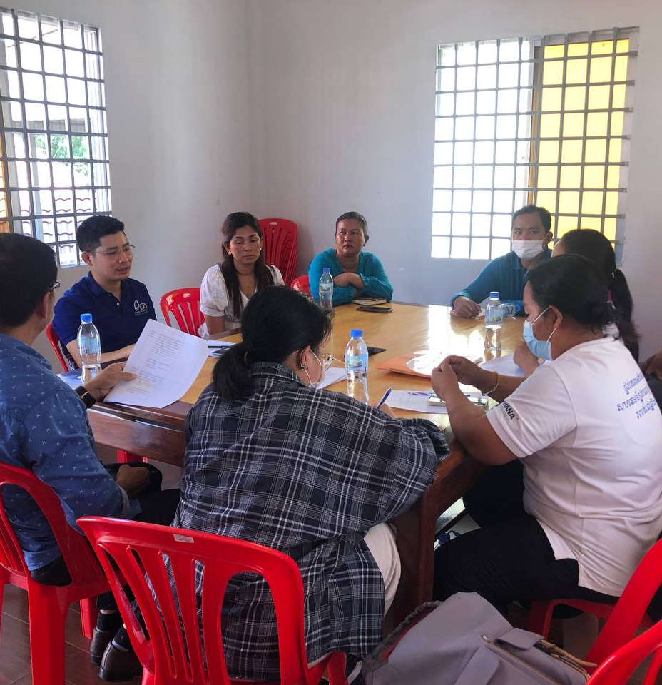
Moving to PPR Literacy Introduction to COPPER CLM and CE COmmunities in Pandemic Preparedness and Response (PPR) through Community-led Monitoring (CLM) and Community Engagement (CE)

Slide 2
Introduction to COPPER

Slide 3
Evolution of CLM CMLI and CELG to COPPER From responding to C19 and its impact to strengthening communities’ role in pandemic preparedness and response and systems readiness through community-led monitoring and engagement
Opportunities to shift to PPR:
Build on CELG progress to date and lessons learned, facilitate and ensure community engagement through:
PPR engagement plans;
National PPR multistakeholder platforms, and
PPR Community of Practice
Catalyse other PPR priority areas including CHW, surveillance, laboratories, among others
AMR HLM in 2024 is a key opportunity to engage communities in a PPR related issue
Institutional Capacity Building, TA and Coordination
CELG
CLM PPR
CE PPR
Communities in PPR
Ecosystem
CHW, surveillance, AMR, laboratories
Key Learnings from CLM CMLI Phase 1:
Re-designing the CLM TA approach aligned with a CLM maturity model
Focusing on a subset of priority counties with a series of TAs within a longer period to monitor progression
Long-term investments on CLM systems that complements other CSS interventions (institutional capacity building and community engagement) so that community and health systems are ready and able to adapt and respond to future outbreaks/pandemics
Opportunities to operationalize this shift of CLM for PPR given the increased CLM investment in both C19RM grants and GC7 grant
CLM CMLI
Increased investments on CLM in PO Wave 2 (C19RM extended until 2025) - $31 million so far in 28 countries*
Increased investments on CBM/CLM from $26 million in GC6 approved grants to nearly
$60 million CLM investments in 44 countries so far from GC7 funding requests
3
*Note: C19RM and GC7 FR CLM amounts are not yet final; datasets from 1/2024 and 11/2023.
Notes:
From these evolving needs, there are three key themes have come up. building institutional capacity for advocacy and surveillance will be critical for effective CLM and CE implementation in the context of PPR. To address these themes, there will be need to channel both existing and additional CLM and CE funds towards enhancing the capacity of CSOs and CBOs around CLM and CE for PPR, enhance existing CLM and CE systems for PPR adaptation, and identify additional CSOs and stakeholders to be engaged.
CLM CMLI Phase 1:
All targets achieved with Phase 1 investments on (a) short-term technical assistance (b) TA coordination, QA and documentation, and (c) and evidence and learning.
Phase 1 resulted in 22 technical assistance assignments in 13 countries to support CLM adaptation to C19 which gave visibility to the impact of C19 in HTM services and 5 focal points who documented learning and case studies from the support, with key results from countries like Kenya and Moldova, to name a few.
12 CLM technical resources (with C19 context) utilized for CLM TA and implementation, including co-convening a Global CLM Meeting to share learnings from C19 and foster-south-to-south learning.
Community Engagement and Leadership in Pandemic Governance
Engagement from C19RM FR development process to governance processes
The Challenges:
Communities have limited access to information and are not included in PPR decision-making fora
Absence of systematic PPR capacity development strategies and plans for most vulnerable and marginalised communities
Weak consultation and coordination in development and oversight of PPR policies and programs
Stigma and discrimination against most vulnerable and marginalised communities
Objectives:
1. Identify, test and document engagement approaches and strategies to enable KVPs through TB networks to influence COVID19 and PPR decisions
2. Identify and facilitate access to technical support
3. Embed lessons/learning from COVID19 2.0 into PPR GF related processes
Deliverables:
1. Engagement mechanism that facilitate the inclusion of community perspectives and expertise in TB, COVID19 and PPR governance, planning, implementation, accountability country processes and platforms developed and/or strengthened.
2. Identified and strengthen approaches and strategies to ensure the KVPs have capacity to engage in country TB, COVID19 and PPR processes
3. Nurture partnerships and foster collaboration between communities, civil society, governments, and TA providers that support and facilitate engagement of KVPs in TB, COVID19 and PPR processes.

Slide 4
COPPER Objectives (2024-2025 implementation) – From responding to C19 and its impact to strengthening communities’ role in pandemic preparedness and response and systems readiness through community-led monitoring and engagement
CLM
CE
Building the capacity of CLM implementers on country governance, core concepts, and systems requirements of PPR
Objective 1: Improve monitoring, analysis and linkages to selected elements of PPR* programs and interventions that are priority to communities and appropriate for CLM initiatives
Build Knowledge and capacity of communities on PPR
Ensure communities have access to accurate and timely information, tools and resources on PPR.
Strengthen capacity of communities at national level and facilitate their engagement in country level PPR decision-making fora.
Strengthen meaningful community engagement in PPR governance
Support meaningful community engagement in PPR governance, implementation and oversight including, national level multistakeholder PPR processes and mechanisms, CCMs, national intergovernmental JEEs and SPAR platforms
Support coordination, evidence generation and use
4. Enhance coordination and networking both within the traditional HTM communities and in partnership with PPR actors to create a shared PPR vision that integrates health equity, human rights, and gender equality in agile and responsive systems for health.
1. TA
*Example: Immunization programs, laboratory services, surveillance, IPC, AMR, health service utilization, RCCE, medical oxygen and respiratory care
Strengthen community and health systems readiness through utilization of CLM data on HTM and PPR
Objective 2: Strengthening national community/civil society networks (working on health) and CLM implementers’ engagement and advocacy capacity in CLM data use for decision-making in PPR spaces/platforms at local, national and sub-national level
Evidence and Learning
Objective 3: Generate evidence on the impact of CLM in PPR programs in improving HTM services and PPR platforms, developing key resources/tools on CLM and PPR, and collaborating with technical partners, donors and communities / civil society to capture and disseminate best practice approaches, and contribute to the development of scientific literature on the role of CLM in PPR and RSSH.

Slide 5
COPPER Key Interventions:
COPPER CE interventions:
1. Provide most impacted communities with tools and resources to ensure strengthened knowledge and capacity to engage in PPR decision making
Tools/resources developed, repackaged and disseminated
Countries host PPR trainings (online and physical)
CoP bi-monthly global learning/dialogue online webinars
Quarterly meetings in countries
2. Generate and use evidence to identify and articulate community PPR priorities that address human rights and gender related violations in pandemic strategies and planning
National level PPR community and CS coalitions develop and drive a PPR advocacy agenda
3. Strengthen national community coordination platforms to engage in PPR and influence national PPR decision making and oversight
National level community platforms incorporate HTM and PPR actors for knowledge sharing and developed
4. Build multisectoral public, private partnerships and platforms that support community engagement in PPR
PPR advocacy agenda developed in each country
Joint multistakeholder agenda developed in each country
Adoption of PPR representation guidelines
COPPER CLM interventions:
Intervention 1: Series of technical assistance
Delivery of on-demand TAs on CLM-PPR literacy/adaptations/expansion in 15 priority countries
Intervention 2: TA coordination and oversight, engagement of focal points, and participation and advocacy support
Engaging southern-led TA provider consortiums to deliver interventions, focusing on TA support/coordination/documentation, and PPR engagement and advocacy
Intervention 3: Evidence building, learning and complementary support interventions
Co-organizing CLM-PPR related global/regional meeting/convenings, capacity building, south-to-south learning exchange
Development of new CLM-PPR complementary tools and resources
Engaging learning hubs for wider dissemination of CLM-PPR information and resources
Support implementation of CLM research agenda
Monitoring, evaluation and learning support activities
PPR literacy is a prerequisite to communities understanding and championing the Global Fund’s contribution to PPR.
This requires investment in national capacity, coordination and engagement of a broader, more inclusive set of community stakeholders to effectively influence national and subnational PPR platforms and decision-making.

Slide 6
COPPER Outcomes:
Greater knowledge and capacity of community, civil society and CLM implementers on PPR governance, key concepts, finance and strategies (global and national).
Community voices and leadership through engagement and utilization of CLM data in national PPR technical working groups, steering committees, decision-making platforms at national level.
Deepening and expanding partnerships and collaboration between traditional HIV, TB and malaria communities and CLM implementers with PPR actors
Integration of human rights and gender equality in PPR strategies, plans and budgets
Improved global approach to community-led monitoring and engagement in pandemic preparedness and response planning
Strengthened community and health systems readiness to be capable to prevent, identify and respond to future pandemics or outbreaks.

Slide 7
COPPER Priority Countries (2024-2025)
Countries (Region) | COPPER CLM | COPPER CE
1. Nigeria (HIA1)
2. Democratic Republic of Congo (HIA1)
3. Burkina Faso (HIA1)
4. Kenya (HIA2)
5. Zambia (HIA2)
6. Philippines (HIAs)
7. Malawi (SEAf)
8. Liberia (WCA)
9. Cameroon (WCA)
10. Senegal (WCA)
11. Mozambique (HIA2)
12. Namibia (SEAf)
13. Haiti (LAC)
14. Central African Republic (WCA)
15. Sierra Leone (WCA)
16. Cambodia (HIAs)
17. Indonesia (HIAs)
COPPER CLM 15 Priority Countries:
Confirmed – 15
COPPER CE 8 Priority Countries:
Confirmed – 7
Awaiting response – 1
COPPER priority countries are also part of the 42 cohort countries for RSSH-PPR implementation, where different CMLI and SI TAs are offered
Notes:
COPPER-CLM - Considerations for country prioritization:
CLM investments in C19RM/PO Wave 2 grants
Linkage to CLM investment in GC7 FRs (9 countries so far)
CELG/CE-PPR priority country (6 countries)
CLM CMLI Phase 1 or CLM SI TA supported countries (6 countries)
Synergies with other CMLIs (SONAR/RTSL-surveillance or STELLAR-labs or BIRCH-CHW) (all 10 countries)
Context of existing CLM mechanism in the country and consultation with CTs and CRG investment advisors
COPPER-CE considerations:
Country selection criteria: Has investments in other CLMIs including SONAR, BIRCH, COPPER CLM, regional balance, CELG country (leverage on the ongoing partnership)
* CELG existing countries with implementing partners

Slide 8
COPPER CLM and CE Alignment
Philippines, Liberia, Kenya, Nigeria, Cameroon, Sierra Leone
PPR literacy and systems adaptation
Coordination and networking
Policy advocacy and engagement
Governance
Tools and resources
Trainings
TA support for the expansion/ adaptations of CLM mechanisms to include PPR
Networking and coalition building (HTM communities, CLM implementers and PPR CS)
Dialogue and sharing lessons and information
CLM-PPR data as source of evidence for decision making
Advocacy planning and monitoring
Case studies and documentation
Representation on CCM, TWG, PPR platforms
Communities and government relationship building

Slide 9
COPPER CLM and CE next steps
COPPER CLM TA Providers
Selection of TA providers – finalized, to be announced on the week of 15 April
TA provider IQC starts: 15 April
Coordination with CTs to identify specific TA needs and draft TORs: within April
On-demand TA available starting: 1 May
COPPER CE Implementers
Contract extension of TB regional networks (ACT AP, ACT Africa) – finalized
Continue working with CE country partners working on LMPs (and include HIV, malaria); identifying a country partner in Liberia
Dissemination of CELG case studies; brown bag sessions: Within April
COPPER CE starts: 1 May
COPPER Inception Meeting and PPR Training – May 14-17, 2024 / Johannesburg, SA
Participants: CLM country implementers, CE country partners, CSOs working on PPR, TA providers, regional network implementers, PPR technical partners
Notes:
COPPER Inception Meeting:
Agenda: 2 days COPPER orientation and planning; 2 days for PPR literacy training
Venue: Nairobi, Kenya
Participation: 60+
Broad Objectives:
Present accomplishments and key learnings from previous phase – CELG and CLM C19RM
Orient implementers and TA providers on COPPER – structures, alignment between the two investments, objectives, outcomes and reporting, review of templates (workplan and reporting)
Work planning for 2024-2025 implementation
PPR literacy training for implementers, TA providers, country partners

Slide 10
Thank You!
CLM C19RM SPO: Raine Cortes
raine.cortes@theglobalfund.org
Senior Technical Advisor, CRSS: Keith Mienies
keith.mienies@theglobalfund.org
Advisor, COVID-19 CE: Olive Mumba
olive.mumba@theglobalfund.org
Senior Technical Advisor, CE: Gavin Reid
gavin.reid@theglobalfund.org

