Slide 1
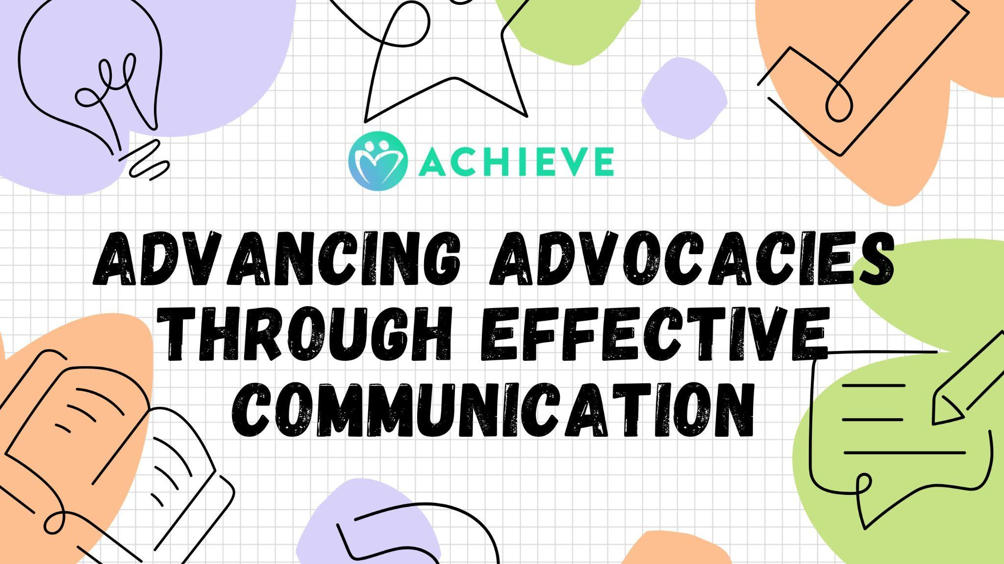

Slide 2
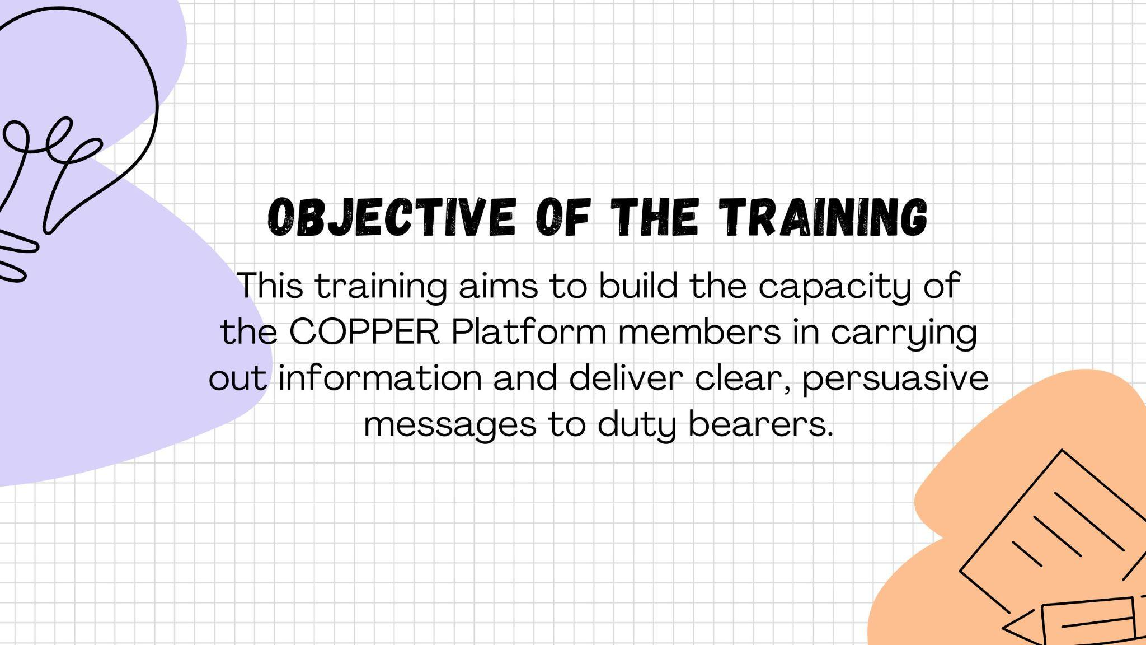

Slide 3
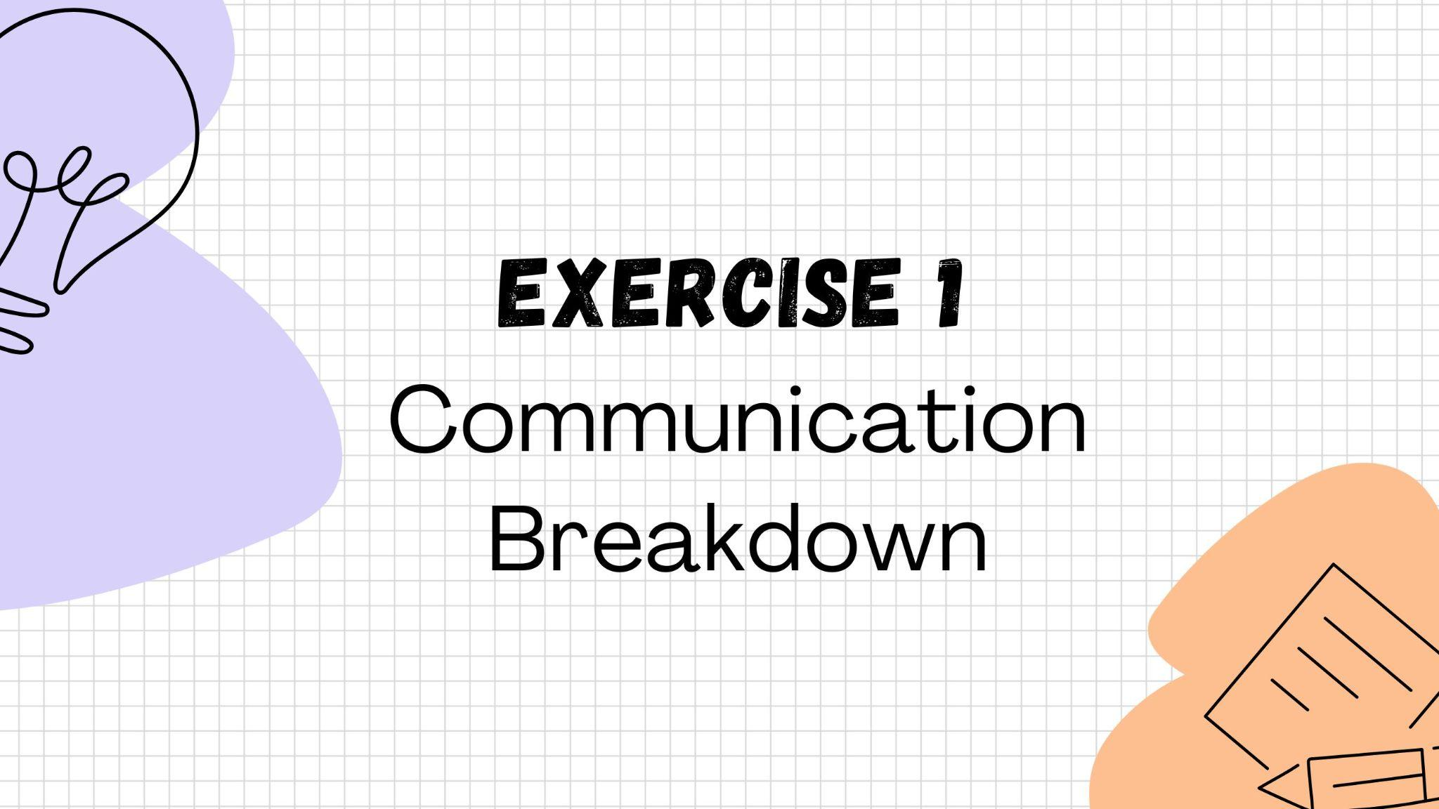
Story

Slide 4
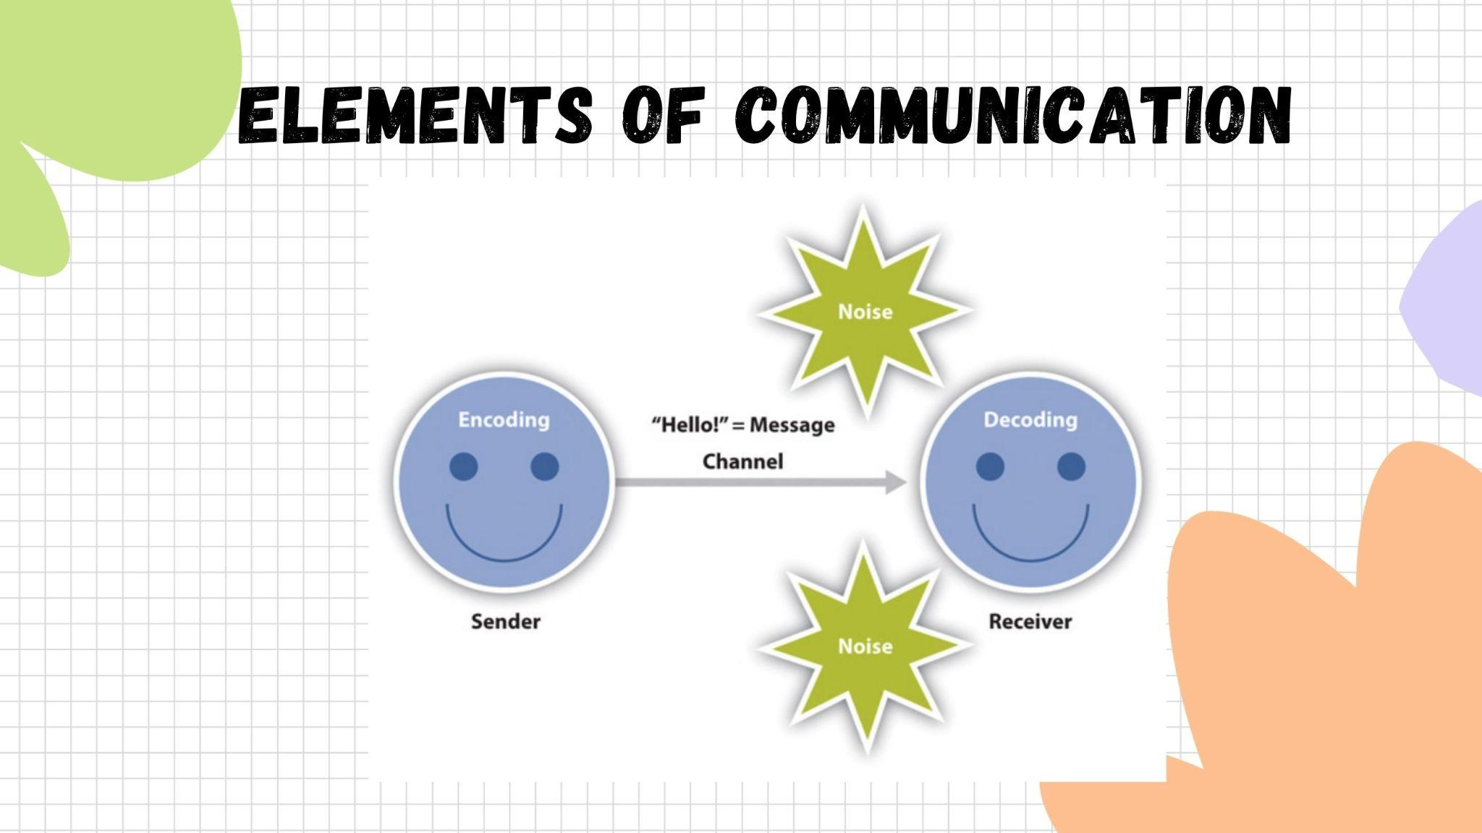
Communication
Communication Is the act or process of using words, sounds, signs, or behaviors to express or exchange information or to express your ideas, thoughts, feelings, etc., to someone else. (Transmission)

Slide 5
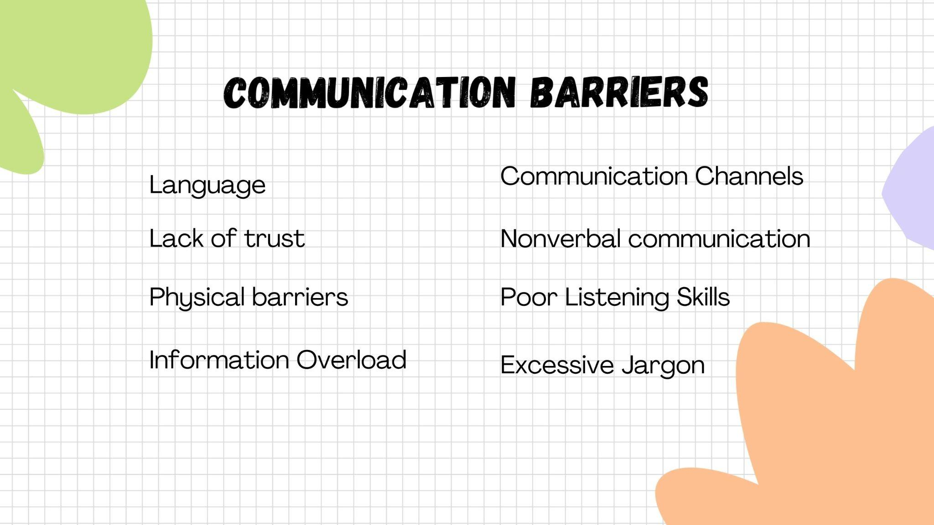
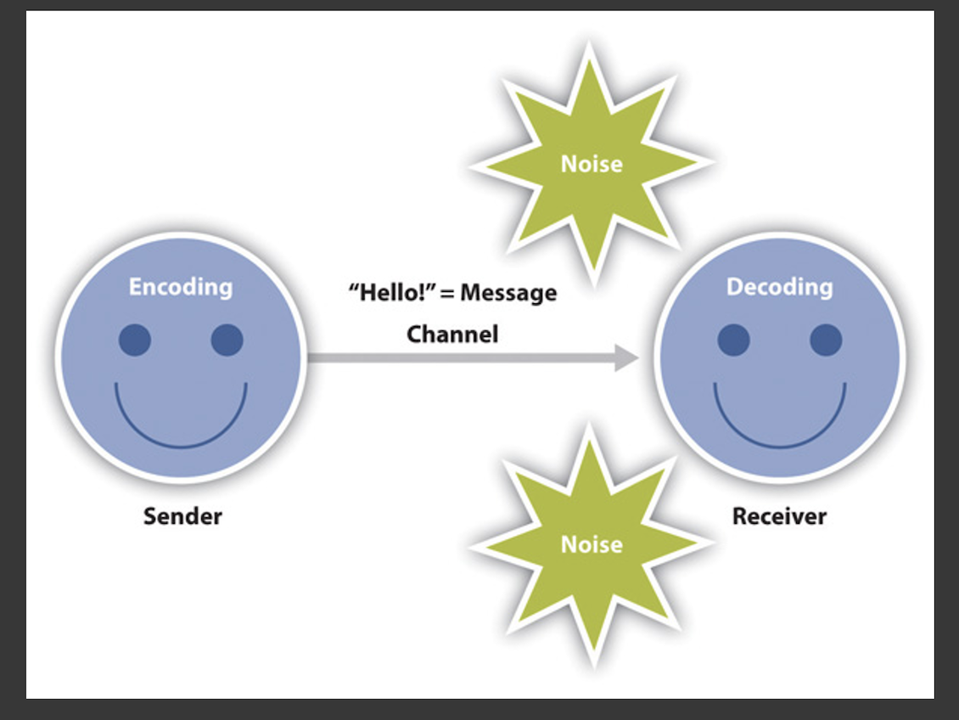
Communication as Transmission

Slide 6
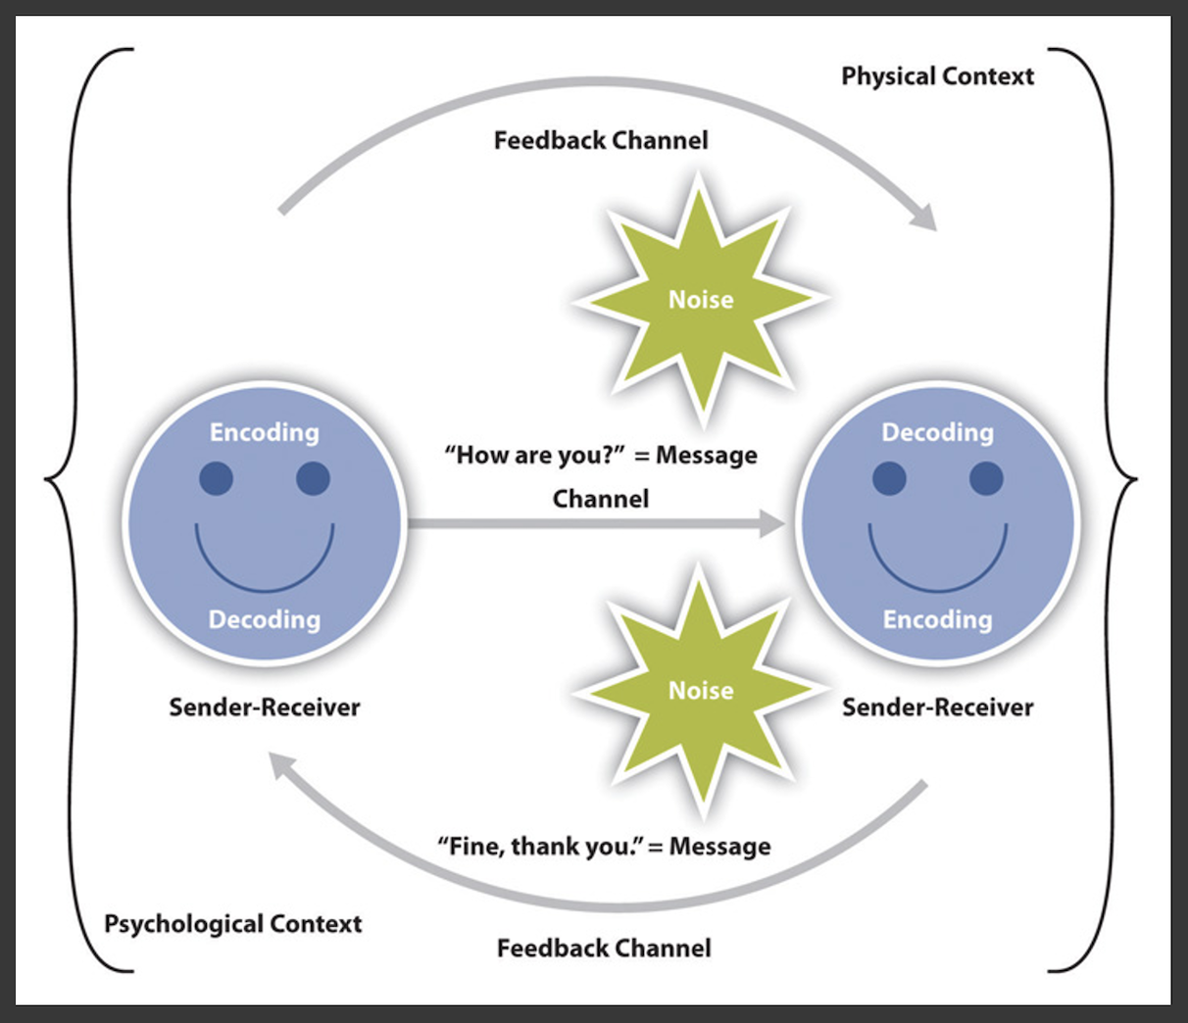
Communication as interaction
Communication is any exchange of message/s or information between or among people. It may be verbal or non-verbal, printed or broadcast, personal or en masse, through social media or any channel or medium
Basic Elements of a Communication: Sender - the one giving the information Receiver – the one receiving the information. The receiver are also called Audience. Note, however, that the continuing exchange between the sender and receiver will make the communicators both sender and receiver. Message – the information being communicated Channel or Medium – the manner through which the message is being sent. Feedback – the receiver’s response to the message Effect – the resulting consequence (good, bad or inconsequential) that the message may invoke in the receiver or evoke in the situation. “Noise” - any hindrance or barrier to get the message across.

Slide 7
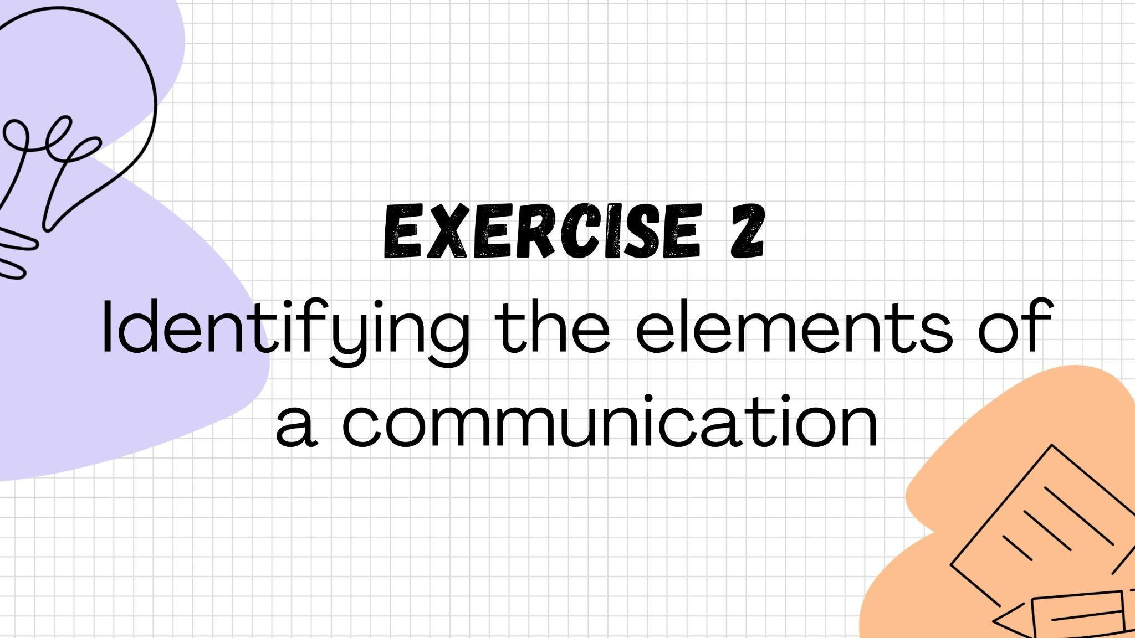

Slide 8
Factors contributing to a good communication setting
Audience
Identify your audience
What are their characteristics?
What will interest them?
Message
Make your message
Interesting to get the attention of your particular audience
Ensure your message will get through them
Channels
Identify the appropriate channel or medium for your message to the chosen audience

Slide 9
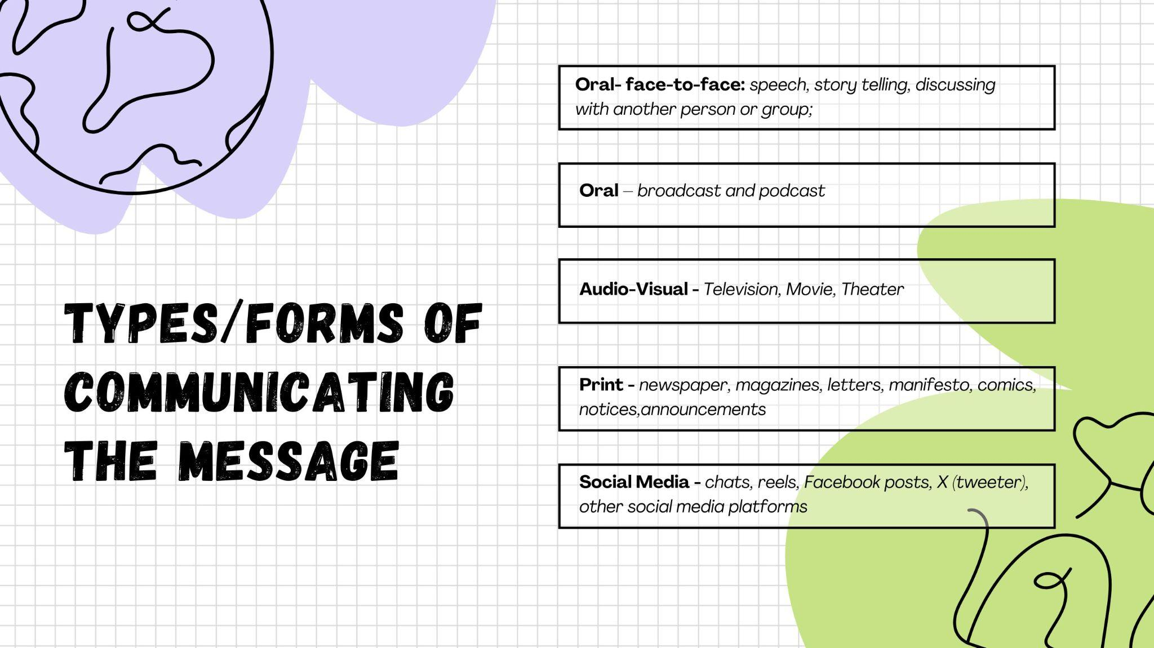

Slide 10
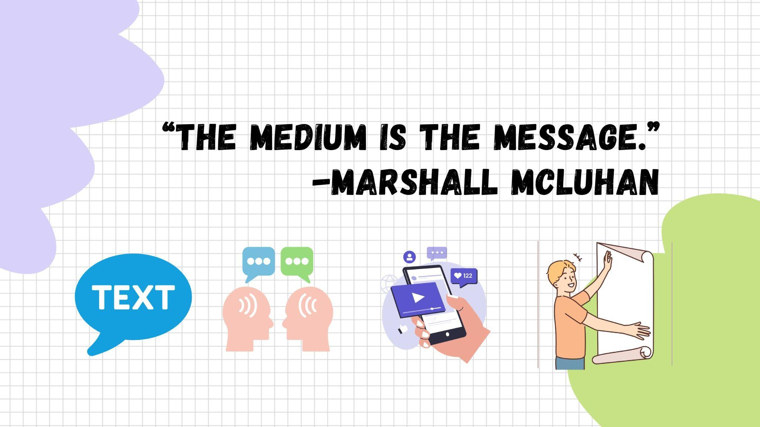
The form and characteristics of a communication medium have a more significant and lasting impact on society and individuals than the specific content it carries
These media influence our perception of information and our experiences, as well as changes our behaviors

Slide 11
The medium is the message- why is it important?
Shifts perception:
The medium influences our senses and how we process information.
  a Tiktok commentary, due to its visual and auditory nature, attracts the viewer to act immediately (buy the product; get angry, get pleased) than a printed one.
Changes society:
New media technologies, such as social media, transform social structures and human interaction more profoundly.
  social media platforms like Facebook, X, Grind’r and others give rise to brave responses and at times aggressive behavior because of the anonymity the medium lends to the receivers of the messages.
Affects thought patterns:
McLuhan believed that media forms can change the way people think. For instance,
  messages delivered face-to-face and orally allows immediate response, be it in a good or a bad way
  Meanwhile a message delivered in print allows the receiver to analyze what the message meant, and then respond.
The experience matters:
Receiving information through a particular medium creates a unique experience and has direct consequences. A text message, by its nature, conveys urgency and urgency differently than a phone call, even if the words are identical.

Slide 12
Medium or Channels for Advocacy
Business Letters
Manifesto
Advocacy materials – exhibits, briefers, posters
Events – such as dialogues (but with prepared talking points), rallies, forum, panel discussion

Slide 13
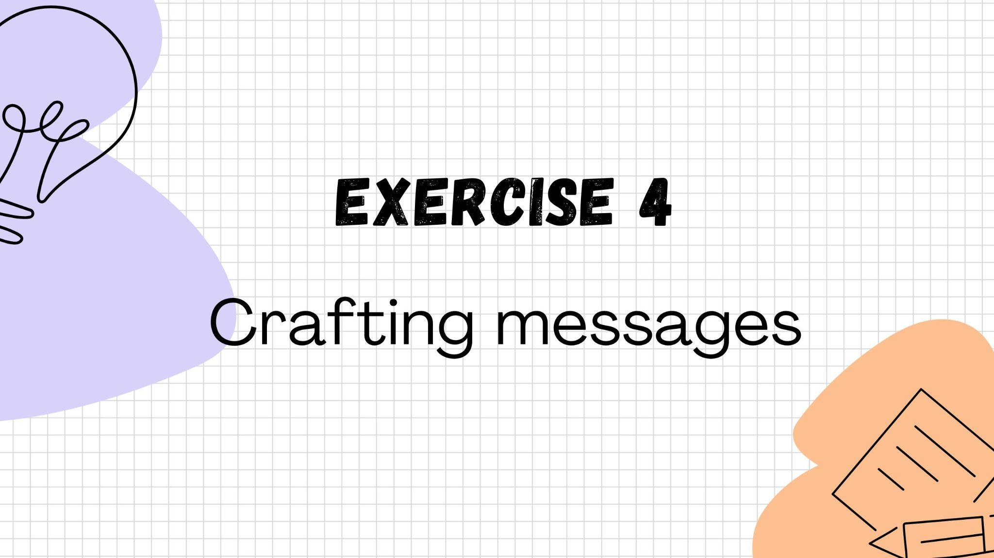

Slide 14


